Slide 1
Senior Leadership Brief
INCIDENT TYPE / INCIDENT NAME
Month DD, YYYY 6:00 a.m. ET
AB
Current Situation: The current situation is typically written/approved by a Senior Leader, such as the Regional Division Director, NRCS Chief, SCO, SAS Chief, Planning Chief, or Team Lead. It captures the State/Tribe/Territory leaders' objectives and/or priorities along with how FEMA (Field, Region HQ) supports those priorities. It also presents an overview of the ongoing response and recovery efforts at a high level. It encompasses vital information regarding the measures undertaken by FEMA and federal partners to assist a state or region affected by a significant event.
LIFELINES SUMMARY
SAFETY & SECURITY (GY) | Law Enforcement/Security: Fire Service: Search & Rescue: Government Service: Community Safety:
FOOD, HYDRATION , SHELTER (GY) | Food: Hydration: Shelter: Agriculture:
HEALTH & MEDICAL (GY) | Medical Care: Patient Movement: Public Health: Medical Supply Chain: Fatality Management:
WATER SYSTEMS (GY) | Potable Water Infrastructure: Wastewater Management:
GRAPHIC PLACEHOLDER
LIFELINES SUMMARY
ENERGY (GY) | Power Grid: Fuel:
COMMUNICATIONS (GY) | Infrastructure: Alerts, Warnings & Messages: 911 & Dispatch: Responder Communications: Finance:
TRANSPORTATION (GY) | Highway/Roadway/Motor Vehicle: Mass Transit: Railway: Aviation: Maritime:
HAZMAT (GY) | Facilities: Hazmat, Pollutants, Contaminants:
TEMPLATE TIER 1
SINGLE STATE
ACTIVATIONS & EMERGENCIES | FEMA | NRCC: NWC: FEMA Responders:
 | AB | Declaration: State of Emergency: State EOC: Describe the activation level in detail: Ex. EOC Level 1 (full activation) IMAT:

Slide 2
Senior Leadership Brief
INCIDENT TYPE / INCIDENT NAME
Month DD, YYYY 6:00 a.m. ET
AB
EF
CD
Current Situation: The current situation is typically written/approved by a Senior Leader, such as the Regional Division Director, NRCS Chief, SCO, SAS Chief, Planning Chief, or Team Lead. It captures the State/Tribe/Territory leaders' objectives and/or priorities along with how FEMA (Field, Region HQ) supports those priorities. It also presents an overview of the ongoing response and recovery efforts at a high level. It encompasses vital information regarding the measures undertaken by FEMA and federal partners to assist a state or region affected by a significant event.
LIFELINES SUMMARY
SAFETY & SECURITY | AB (GN) | NEW | Minimal Impact: Green (GN) Indicates that the lifeline is functioning at pre-incident levels through pre-incident systems, with only minor disruptions or limitations. The community’s essential services and resources associated with that lifeline are being adequately provided. Ongoing monitoring and maintenance is necessary to sustain this level of functionality RGB 94-156-66 / HEX #5E9C42
 | CD (YL) | NEW | Moderate Impact: Yellow (YL) Indicates that there are disruptions or limitations affecting the delivery of services and resources. While the situation is not as critical, it still requires attention and proactive measures to prevent further deterioration and ensure community needs are met. This includes any situations where resources are provided to temporarily address the impacts. RGB 251-186-22 / HEX #FBBA16
 | EF (RD) | NEW | Significant Impact: Red (RD) Indicates there are severe challenges and obstacles hindering the provision of essential services and resources associated with that lifeline. Immediate attention and resources are required to address the situation and restore functionality RGB 197-32-56 / HEX #C52038
FOOD, HYDRATION, SHELTER | AB (GY) | Unknown: Grey (GY) Indicates the extent of disruption and impacts to lifeline services is unknown RGB 145-147-149 / HEX #919395
 | CD (BL) | Administrative: Blue (BL) Does not indicate an operational status or condition; used for administrative purposes such as presentations and briefings RGB 1-82-135 / HEX #015287
 | EF (GY)
HEALTH & MEDICAL | AB (GY)
 | CD (GY)
 | EF (GY)
WATER SYSTEMS | AB (GY)
 | CD (GY)
 | EF (GY)
GRAPHIC PLACEHOLDER
LIFELINES SUMMARY
ENERGY | AB (GY) | Formatting Guidelines NEW | Body Text: Calibri (Body) Size 10 Sources: Calibri (Italics) Size 8 New Information: Blue (RGB 0-0-255 / HEX #0000FF)
 | CD (GY)
 | EF (GY) | Status (What?) Summarize the root cause(s) of disruption to lifelines services
COMMUNICATIONS | AB (GY) | Impacts (So What?) Explain the disaster impacts to specific communities, disaster survivors, and response operations. Detail how the survivor experience or response operation will improve if this component is addressed. Specify the impacted areas and population totals
 | CD (GY) | Actions (Now What?) Describe the actions that are being taken to address the disrupted services. Summarize the most critical actions being taken across the Whole Community
 | EF (GY) | Limiting Factors (What’s the Gap?) Express issues that are preventing services from being re-established. Such issues can stem from another lifeline/component, resource shortfall, management, policy, etc.
TRANSPORTATION | AB (GY) | Estimated Time to Status Change and Re-establishment Requirements (When?) Provide current component condition or an estimated timeframe for when a change in condition is expected
 | CD (GY)
 | EF (GY)
HAZMAT | AB (GY)
 | CD (GY)
 | EF (GY)
TEMPLATE TIER 1
MULTI-STATE
ACTIVATIONS & EMERGENCIES | FEMA | NRCC: NWC: FEMA Responders:
 | AB | Declaration: State of Emergency: State EOC: Describe the activation level in detail: Ex. EOC Level 1 (full activation) IMAT:
 | CD | Declaration: State of Emergency: State EOC: IMAT:
 | EF | Declaration: State of Emergency: State EOC: IMAT:

Slide 3
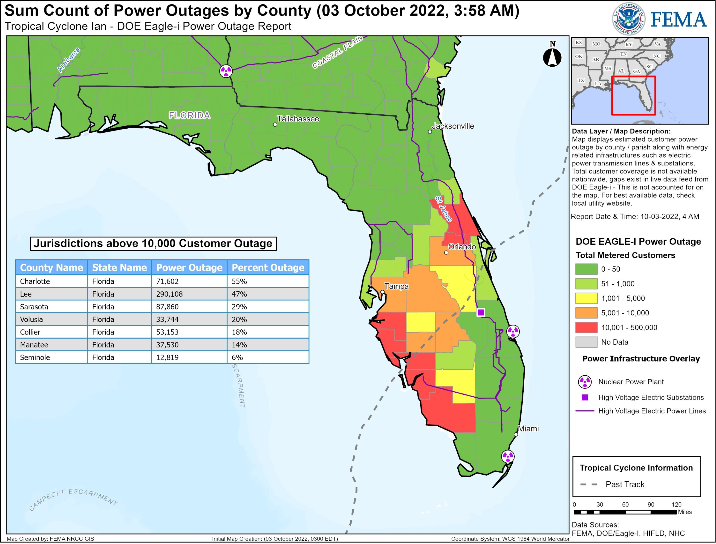
Senior Leadership Brief
TROPICAL CYCLONE / ROBERTO
October 4, 2022 6:00 a.m. ET
MS
FL
AL
Current Situation: FEMA and federal partners continue to support the States of Mississippi, Louisiana, and Texas in response and recovery from the impacts of Tropical Cyclone Roberto. Federal teams, commodities, and equipment are delivering support to lifesaving and life-sustaining requirements across the impacted areas, including medical decompression, and patient transport. Mission priorities continue to be focused on restoration of utilities (including power and water) to critical infrastructure within the impacted area, with special emphasis on hospitals, long-term care facilities, and other medical facilities. Search and rescue operations, commodity distribution, and damage assessments are ongoing, and the need for additional federal resources continues to be assessed as requirements develop.
LIFELINES SUMMARY
SAFETY & SECURITY | MS (RD) | Search and Rescue: 3,404 (+674) people and 155 pets rescued via ground, air, and sea by MS National Guard, USCG, and US&R (numbers do not include rescues by local authorities and other entities) (ESF-9 Update, 10/4/22, 1:42 am ET)
 | AL (GR)
 | FL (GY)
FOOD, HYDRATION , SHELTER | MS (YE) | Food: MS ordered 8.1M (+2.9M) meals and 8.4M (+900K) liters of water; 3.7M (+800K) meals and 5M (+1.1M) liters of water delivered; additional balance and other commodities shipping from Maxwell ISB as MS requests (infant/toddler kits, blankets, cots, tarps, sheeting, and rescue ladders) (ESF-7 Update, 10/3/22, 11:03 pm ET)
 | AL (BL)
 | FL (YE)
HEALTH & MEDICAL | MS (YE) | Medical Care: At least 128 (-10) healthcare facilities impacted across the state, impacting 5,655 (-819) patients or residents and 2,085 staff; damage assessments in progress; 2 USACE teams continue conducting power assessments at State Hospitals (ESF-8 Update, 10/4/22, 3:40 am ET)
 | AL (RD)
 | FL (RD)
WATER SYSTEMS | MS (GY)
 | AL (GY) | Potable Water Infrastructure: Precautionary BWA issued Statewide; damage assessments will begin 10/6 (ESF-7, 10/4/22, 1:17 am ET)
 | FL (GY)
LIFELINES SUMMARY
ENERGY | MS (GR) | Power: 84% (+6%) of peak power outages restored; 442,995 (-154,388) customers without power (ESF-12 Update, 10/4/22, 12:25 am ET)
 | AL (GR)
 | FL (GR)
COMMUNICATIONS | MS (YE)
 | AL (GR) | Infrastructure: 96.2% of cell sites in the affected area are operational and in-service (ESF-2 Update, 10/4/22, 12:37 am ET)
 | FL (GR)
TRANSPORTATION | MS (YE) | Aviation: Gulfport-Biloxi Int’l remains closed except for humanitarian flights with prior permission; expected to open 10/7 for limited commercial flight ops 8:30 am to 6:00 pm; plans to reopen 10/9 (ESF-1 Update, 10/3/22, 7:30 pm ET)
 | AL (YE)
 | FL (YE)
HAZMAT | MS (RD)
 | AL (RD)
 | FL (GR) | Facilities: Hazmat assessment teams completed 57 of 57 hazardous waste facilities identified by FDEP; no issues identified (ESF-10 Update, 10/3/22, 11:46 pm ET)
TEMPLATE TIER 1
MULTI-STATE WITH EXAMPLES
ACTIVATIONS & EMERGENCIES | FEMA | NRCC: Fully Activated (24/7) NWC: Monitoring
 | MS | Declaration: FEMA-1234-EM-MS approved 10/1/22; designated FCO Michael Scott State EOC: EOC Level 1 (Full Activation) IMAT: R4 IMAT in SEOC
 | AL | Declaration: State of Emergency: State EOC: IMAT:
 | FL | Declaration: State of Emergency: State EOC: IMAT:

