Slide 1
Human Biases: Why People Underprepare for Disasters
PrepTalks. Logos for the Federal Emergency Management Agency, International Association of Emergency Managers, National Emergency Management Association, National Homeland Security Consortium, and Center for Homeland Defense and Security Naval Postgraduate School.
Dr. Howard Kunreuther
Notes:
Facilitator Tips
These tips are only suggestions on how to conduct a session. Please be creative and adaptable to your audience and needs.
We strongly recommend you watch the PrepTalk and review the Discussion Guide before facilitating the session.
Facilitator Narrative
“Welcome to a PrepTalk viewing and discussion for Jan Peelen’s PrepTalk, ‘’Living with Water: Howe the Netherlands Prevents Flood Disasters”. PrepTalks are given by subject-matter experts and thought leaders to spread new ideas, spark conversation, and promote innovative leadership for the issues confronting emergency managers now and over the next 20 years. You can watch all PrepTalk videos at www.fema.gov/preptalks.
Before we get started, lets establish some ground rules:
Please silence or set your cell phones to vibrate.
Please feel free to leave quietly if you need to make a call, use the restroom, or otherwise need to leave.
The emergency the exits are…
The restrooms are located…
Please keep your comments brief to allow everyone to participate.
This is your discussion and I will help focus on the issues that matter to you, so we do not necessarily have to cover all of the content.”

Slide 2
Agenda
Human Biases: Why People Underprepare for Disasters
Dr. Howard Kunreuther
Agenda
Introductions (5 minutes)
Watch the PrepTalks (20 minutes)
Discussion (30 minutes)
Wrap-up (5 minutes)
Notes:
Facilitator Tips
Prepare the audience by setting clear expectations. The suggested timing is below, for a one hour session discussion will be about 30 minutes.
Introductions (~5 minutes)
Watch the PrepTalk (~20 minutes)
Discussion (~30 minutes)
Wrap-up (~5 minutes)
Facilitator Narrative:
“Now that we established our ground rules, let’s go over the agenda. First, we will introduce the speakers and ourselves. Second, we will watch the PrepTalk and Q&A videos. Third, we will have a discussion among ourselves on the content. Finally, we will wrap-up and I will highlight some useful resources.”

Slide 3
Introduction
Human Biases: Why People Underprepare for Disasters
Dr. Howard Kunreuther
Howard Kunreuther serves the following roles at the Wharton School, University of Pennsylvania:
Professor Emeritus of Decision Sciences and Public Policy in the Operations, Information, and Decisions Department
Co-Director of the Wharton Risk Management and Decision Processes Center
Dr. Kunreuther has a longstanding interest in ways that society can better manage low-probability, high-consequence events related to technological and natural hazards
Notes:
Facilitator Tips
Introduce the speakers
Introduce yourself
Introduce the audience to each other
Small audiences. Attendees say their name, position/organization, and respond to a question that relates to the PrepTalk topic.
Large diverse audience:
How many of you work for a local government?
How many of you work for a state government?
How many of you…. (question about the PrepTalks topic)?

Slide 4
Watch the PrepTalk
Human Biases: Why People Underprepare for Disasters
Dr. Howard Kunreuther
https://youtu.be/9-_YeNdzIcg
Topics for Discussion
Cognitive Processes and Biases
Improving Decision Making for Preparedness
Notes:
Facilitator Tips
Let the audience know that it is ok to stop the video if people have questions or want to raise a point for the group. However, watch the entire talk before opening a broader discussion.
Facilitator Narrative
“Now we are going to watch the PrepTalk. As you watch consider the topics for discussion below and be prepared to discuss.” Read the Topics for Discussion

Slide 5
Topic 1: Cognitive Processes and Biases
Human Biases: Why People Underprepare for Disasters
Dr. Howard Kunreuther
Dr. Kunreuther reviews Daniel Kahneman’s research in decision-making under uncertainty
It addresses the concept of two systems of thinking:
System 1: Fast, intuitive thinking, that operates automatically and quickly with little or no effort.
System 2: Slow, deliberative thinking, that allocates attention to decisions and uses intentional mental activities.
We make many of our decisions extremely well with intuitive thinking, but intuitive thinking presents challenges for low-probability/high-consequence events, known as “black swans.” Our brains … are simply not designed to think effectively about how to prepare for rare events.
– Dr. Howard Kunreuther

Slide 6
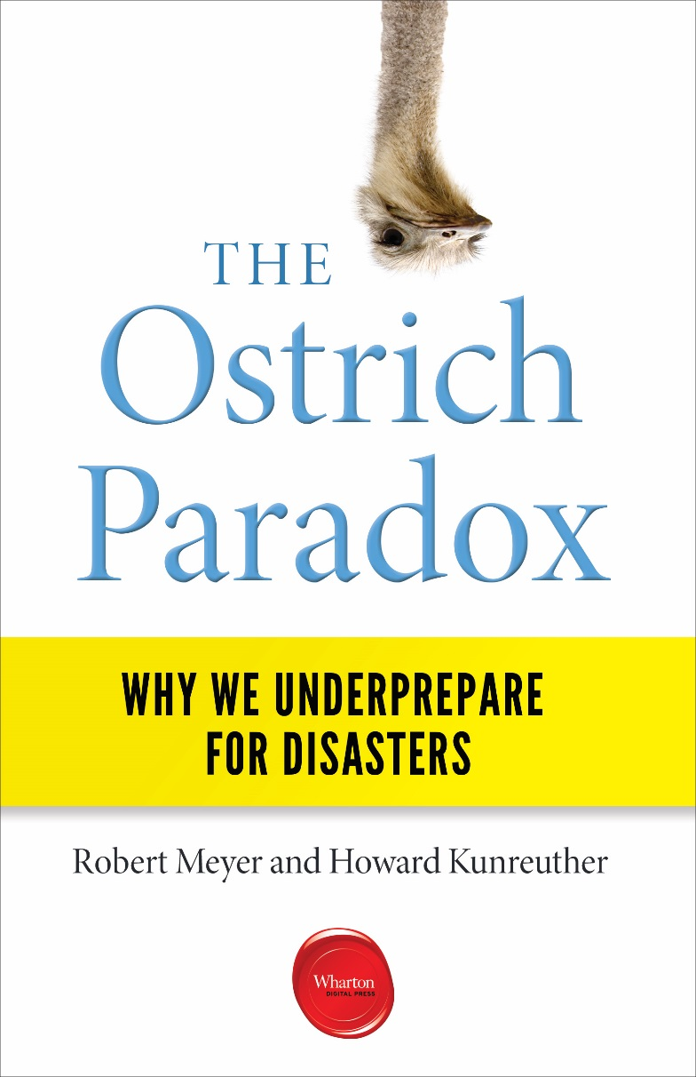
Topic 1: Cognitive Processes and Biases
Human Biases: Why People Underprepare for Disasters
Dr. Howard Kunreuther
Dr. Kunreuther’s research suggests that most preparedness errors in disasters can be traced to the harmful effects of six biases, triggered by System 1 or intuitive thinking, and simplified decision rules, called heuristics.
Bias | Heuristic
Myopia | Focus on short-time horizons in comparing upfront costs of protection with expected benefits from loss reduction
Amnesia | Forget the lessons of the past and decide not to undertake protective measures
Optimism | Underestimate the likelihood of extreme events; they are below one’s threshold level of concern
Inertia | Maintain the status quo because of the time and effort to change and the uncertainty of the outcome
Simplification | Focus on only a few of the relevant factors
Herding | Base one’s choices on the actions of others

Slide 7
Topic 1: Cognitive Processes and Biases
Human Biases: Why People Underprepare for Disasters
Dr. Howard Kunreuther
When individuals are unsure how to best prepare for a disaster, they often choose the option that requires the least amount of mental effort
For example:
Individuals who purchase insurance often choose the lowest deductible (highest premium) to maximize the chance of getting a return from their policy
Following a hurricane warning, individuals may decide to remain in their home rather than evacuate in the hope or belief that the storm will not impact their community
Unfortunately, these choices often do not reflect a systematic analysis of the data and in some cases can lead to tragic consequences
It can be hard to convince people that the best return on an insurance policy is no return at all.
– Dr. Howard Kunreuther

Slide 8
Topic 1: Cognitive Processes and Biases
Human Biases: Why People Underprepare for Disasters
Dr. Howard Kunreuther
Dr. Kunreuther explains that people exhibit not just one of the identified biases, but a combination, creating even more complex challenges to preparedness.
What are examples of the six biases, or combination of biases, you have noticed in your efforts to help people in your community prepare?
What are some examples of the six biases you have observed in decision-making during the response phase? Were the publics’ biases different from those in response operations?
Have you personally experienced these biases in your own decision-making?

Slide 9
Topic 2: Improving Decision Making for Preparedness
Human Biases: Why People Underprepare for Disasters
Dr. Howard Kunreuther
Recognizing these biases and designing strategies that deal with them presents an opportunity to improve preparedness
Dr. Kunreuther proposes a four-step behavioral risk audit, combining protective decision-making with economic incentives, to encourage individuals to undertake preparedness measures:
Step | Activity
1 | List the biases
2 | Describe how biases impact beliefs (creating an underestimation of risk)
3 | Analyze how these biases become evident relative to how individuals prepare or do not prepare (how underestimation of risk impacts preparedness)
4 | Design remedies (incentives and persuasive tactics to overcome lack of preparedness)
The Ostrich Paradox, pages 73-74
We’re not going to change people. We have these biases; let’s work with them. Can we figure out a way to improve dealing with extreme events by linking intuitive and deliberative thinking?
– Dr. Howard Kunreuther

Slide 10
Topic 2: Improving Decision Making for Preparedness
Human Biases: Why People Underprepare for Disasters
Dr. Howard Kunreuther
The Behavioral Risk Audit suggests strategies to overcome each cognitive bias:
Bias | Remedy
Myopia | Long-term mitigation loans coupled with insurance premium reduction
Amnesia | Multi-year fixed insurance contracts so property owners do not cancel their policy if they have no claims
Optimism | Stretched time horizon so that homeowners pay attention; the probability of 1-in-100 annually is 1-in-4 chance of at least one flood in 25 years
Inertia | Add flood coverage to homeowners policy as the default option, with an option to cancel it
Simplification | Focus on the powerful consequences of a flood rather than on its probability
Herding | Seals of approval with certified inspection on well-designed property to create a social norm for protection in hazard-prone areas

Slide 11
Topic 2: Improving Decision Making for Preparedness
Human Biases: Why People Underprepare for Disasters
Dr. Howard Kunreuther
Achieving greater resilience requires collective action
Kunreuther suggests four guiding principles for risk management that should be accepted by key stakeholders, policy makers, and the public:
Principle | Description
1 | Commit to long-term protective planning as a major priority
2 | Commit to policies that discourage individual and community actions that increase exposure to long-term risks
3 | Create policies that consider the cognitive biases that inhibit adoption of protective measures
4 | Commit to addressing problems equitably
The Ostrich Paradox, pages 93-94
We are now having more black swans to deal with. We have events that were very low probability a number of years ago that now have much higher probability. We need key stakeholders to agree on the importance of investing in insurance, cost-effective loss reduction measures, and acting now rather than assuming it will not happen to me.
– Dr. Howard Kunreuther

Slide 12
Topic 2: Improving Decision Making for Preparedness
Human Biases: Why People Underprepare for Disasters
Dr. Howard Kunreuther
Who are the stakeholders you need to be working with to implement the Guiding Principles?
What roles can each of the key stakeholders play in assisting those at risk to prepare for disasters before it is too late?
What remedies can your stakeholders identify and implement to overcome the biases that curtail preparedness actions?
How can information on protective measures and their importance in aiding the recovery process be communicated to homeowners and residents in a transparent manner?

Slide 13
Wrap-up
Human Biases: Why People Underprepare for Disasters
Dr. Howard Kunreuther
Additional Resources
Wharton Risk Management and Decision Processes Center: https://riskcenter.Wharton.upenn.edu
Wharton Issue Brief: “The Ostrich Paradox: Why We Underprepare for Disasters”: https://riskcenter.wharton.upenn.edu/wp-content/uploads/2019/03/Ostrich-Paradox-issue-brief.pdf
Related PrepTalks
The Unthinkable: Lessons from Survivors – Amanda Ripley
Using Complex Adaptive Systems Thinking to Understand Community Interdependencies – Dr. Chick Macal
Triage, Ethics, and Operations – Healthcare Emergency Preparedness and Response: Dr. Sheri Fink
Harnessing the Power of Disaster Insurance – Dr. Carolyn Kousky
Notes:
Facilitator Tips
Wrap-up the discussion
Summarize the key takeaways from the discussion
Emphasize any next steps attendees can take following the discussion
Highlight the additional resources all available on line.
Let them know all the resources (video, discussion guide, and discussion slides) are available at www.fema.gov/preptalks
Additional Resources
Wharton Risk Management and Decision Processes Center: https://riskcenter.Wharton.upenn.edu
Wharton Issue Brief: The Ostrich Paradox: Why We Underprepare for Disasters. https://riskcenter.wharton.upenn.edu/wp-content/uploads/2019/03/Ostrich-Paradox-issue-brief.pdf
Related PrepTalks
The Unthinkable: Lessons from Survivors – Amanda Ripley
Using Complex Adaptive Systems Thinking to Understand Community Interdependencies – Dr. Chick Macal
Triage, Ethics, and Operations – Healthcare Emergency Preparedness and Response – Dr. Sheri Fink
Harnessing the Power of Disaster Insurance – Dr. Carolyn Kousky

Slide 14
PrepTalks. New Perspectives for Emergency Managers.
https://www.fema.gov/preptalks

