Slide 1
Our Changing World: The Challenge for Emergency Managers
PrepTalks. Logos for the Federal Emergency Management Agency, International Association of Emergency Managers, National Emergency Management Association, National Homeland Security Consortium, and Center for Homeland Defense and Security Naval Postgraduate School.
David Kaufman
Notes:
Facilitator Tips
These tips are only suggestions on how to conduct a session. Please be creative and adaptable to your audience and needs.
We strongly recommend you watch the PrepTalk before facilitating the session.
www.fema.gov/preptalks/kaufman
Facilitator Narrative
“Welcome to a PrepTalk viewing and discussion for David Kaufman’s PrepTalk, ‘Our Changing World: The Challenge for Emergency Managers’. PrepTalks are given by subject-matter experts and thought leaders to spread new ideas, spark conversation, and promote innovative leadership for the issues confronting emergency managers now and over the next 20 years. You can watch all PrepTalk videos at www.fema.gov/preptalks.
Before we get started, lets establish some ground rules:
Please silence or set your cell phones to vibrate.
Please feel free to leave quietly if you need to make a call, use the restroom, or otherwise need to leave.
The emergency the exits are…
The restrooms are located…
Please keep your comments brief to allow everyone to participate.
This is your discussion and I will help focus on the issues that matter to you, so we do not necessarily have to cover all of the content.”

Slide 2
Agenda
Our Changing World: The Challenge for Emergency Managers
David Kaufman
Agenda
Introductions (5 minutes)
Watch the PrepTalks (20 minutes)
Discussion (30 minutes)
Wrap-up (5 minutes)
Notes:
Facilitator Tips
Prepare the audience by setting clear expectations. The suggested timing is below, for a one hour session discussion will be about 30 minutes.
Introductions (~5 minutes)
Watch the PrepTalk (~20 minutes)
Discussion (~30 minutes)
Wrap-up (~5 minutes)
Facilitator Narrative:
“Now that we established our ground rules, let’s go over the agenda. First, we will introduce the speakers and ourselves. Second, we will watch the PrepTalk and Q&A videos. Third, we will have a discussion among ourselves on the content. Finally, we will wrap-up and I will highlight some useful resources.”

Slide 3
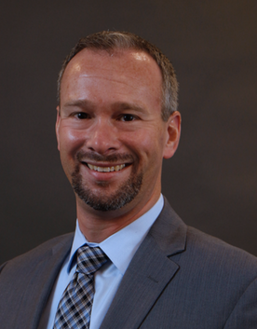
Introductions
Our Changing World: The Challenge for Emergency Managers
David Kaufman
David Kaufman is the Vice President and Director for Safety and Security at CNA, a nonprofit organization that provides operational analysis to advance the safety and security of the United States.
Mr. Kaufman is also a faculty member in Georgetown University’s Emergency and Disaster Management Program and lectures for the Naval Postgraduate School’s Center for Homeland Defense and Security.
Notes:
Facilitator Tips
Introduce the PrepTalk speaker
Introduce yourself
Introduce the audience to each other
Small audiences. Attendees say their name, position/organization, and respond to a question that relates to the PrepTalk topic.
Large diverse audience:
How many of you work for a local government?
How many of you work for a state government?
How many of you…. (question about the PrepTalks topic)?

Slide 4
Watch the PrepTalk
Our Changing World: The Challenge for Emergency Managers
David Kaufman
http://www.fema.gov/preptalks/kaufman
Topics for Discussion
Key Trends
Aging: Population and Infrastructure
Acceleration: Temperature Change and Pace of Change
Asymmetry: Wealth, Politics, Information
Challenges for Emergency Managers
Pathways for Success
Notes:
Facilitator Narrative
“Now we are going to watch the PrepTalk. As you watch consider the topics for discussion below and be prepared to discuss.” Read the Topics for Discussion
Facilitator Tips
Let the audience know that it is ok to stop the video if people have questions or want to raise a point for the group. However, watch the entire talk before opening a broader discussion.

Slide 5
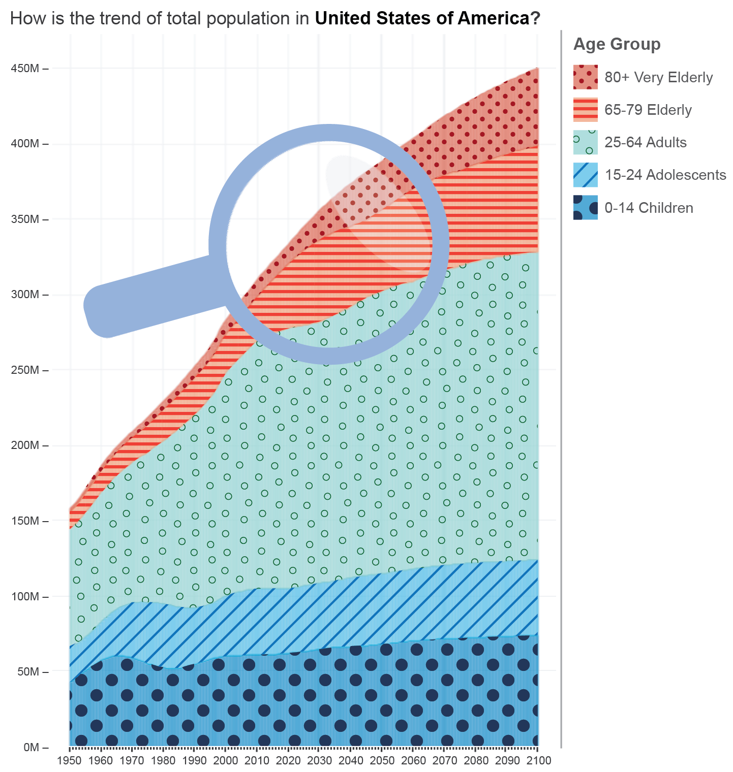
Key Trends Topic 1: Aging
Our Changing World: The Challenge for Emergency Managers
David Kaufman
Populations are Aging:
Currently 16 percent of the U.S. population is over 65
By 2050, 22 percent will be over 65 (approximately 32 million Americans)
Infrastructure is Aging:
Infrastructure is aging and is concentrated in more hazard-prone areas
Over half the U.S. population lives in coastal areas, and 80 percent of those are in urban areas
Notes:
Population source: World Population Prospects, Edition 2015, United Nations
Graphic: magnifying glass highlights years from 2020-2050. Orange is ages 65-79; deeper orange is ages 80+
Infrastructure Report Card from the American Society of Civil Engineers: https://www.infrastructurereportcard.org/

Slide 6
Key Trends Topic 1: Aging
Our Changing World: The Challenge for Emergency Managers
David Kaufman
How does your organization currently support older residents? What are some additional considerations for older populations in disasters, such as:
Social isolation
Evacuation
Medical needs
Recovery considerations
How will your planning change as older populations increase? Will your local infrastructure (e.g., transportation, healthcare, housing) be able to handle this change?
What infrastructure(s) in your community will need updating in the next decade? Roads and bridges? Hospitals?

Slide 7
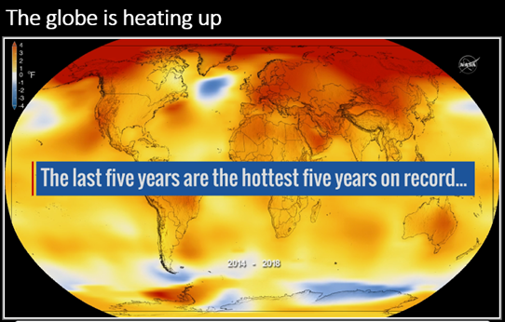
Key Trends Topic 2: Acceleration
Our Changing World: The Challenge for Emergency Managers
David Kaufman
Temperature Change
Exacerbates existing instability
Increases food and water scarcity
Increases “climate refugees”
More effects from variability in extreme weather:
More droughts and more flooding
Extreme heat will buckle roadways and runways affecting transportation of commodities and people
Pace of Change
Cities are expanding:
By 2050 two thirds of the world’s population will live in cities
In the 1950s, it was one third
Notes:
Mega Cities visualization: http://ifuturecities.com/glasgowatlas/#visualizations/megacities
NASA Global Climate Change Visualization: https://climate.nasa.gov/vital-signs/global-temperature/
Climate change may signal more rapid swings between extremes and more intensity and variability in extreme weather, including more concentrated and dense precipitation, more droughts, or flooding.
Changes in erosion patterns affecting infrastructure.
Extreme heat buckling our runways and roadways, and changing the way commodities and people flow.
Urbanization: Institute for Future Cities http://ifuturecities.com/
Swiss Re Institute Natural Catastrophes and man-made disasters in 2017: a year of record-breaking losses: https://www.swissre.com/institute/research/sigma-research/sigma-2018-01.html

Slide 8
Key Trends Topic 2: Acceleration
Our Changing World: The Challenge for Emergency Managers
David Kaufman
Are you seeing changes in extreme weather events in your area? Are you working with weather forecasters to plan for future conditions?
Are you adapting your actions to those changes? Including:
Land use planning
Building codes
Impacts to infrastructure
Emergency Operations Plans
If you are in an urban area, how are you planning for population growth? If you are in a rural area, are you seeing population declines?
How do population shifts impact infrastructure needs, including transportation, housing, and medical needs?

Slide 9
Key Trends Topic 3: Asymmetry
Our Changing World: The Challenge for Emergency Managers
David Kaufman
Wealth Disparity
Between 2009 and 2012, the incomes of the top one percent of Americans grew by 31 percent, while the incomes of the entire 99 percent of the remaining population grew by less than half a percent
Social Movements in Disasters
The public will organize and act
Capacity exists and will grow outside of government; private supply chains are already far more capable than federal emergency assistance (e.g., food delivered to Puerto Rico)
Federal and State Funding Shortfalls
As the U.S. debt grows, less funding will be available for state and local grant programs (roughly 30 percent of state general funds come from Federal tax dollars)
Social Security, Medicare, and Medicaid will increasingly crowd out resources available for discretionary and security programs
Notes:
Deutsche Bank U.S. income and Wealth Inequality Report: https://www.db.com/newsroom_news/Inequality_Jan2018.pdf
The largest food mission FEMA ever attempted was 6 million meals per day to Puerto Rico. This represented only 4-6 percent of the market for food in PR. The assumption was that private grocery sales would be gone; however, that was not the case. The grocery sector persisted and thrived and food sales went up significantly.
Congressional Budget Office Updated Budget Projections 2019-2029: https://www.cbo.gov/system/files/2019-05/55151-budget_update_0.pdf

Slide 10
Key Trends Topic 3: Asymmetry
Our Changing World: The Challenge for Emergency Managers
David Kaufman
Political Polarization
Disparities in attitudes and beliefs between Republicans and Democrats are growing significantly
Information
Large numbers of information sources are available via social media and the internet, which lead the public to overestimate their level of knowledge.
Sixty percent of those surveyed in the Edelman Trust Barometer trust a person like themselves on par with a technical expert or an academic
Notes:
Pew Charitable Trusts Political Polarization in the American Public: https://www.people-press.org/2014/06/12/political-polarization-in-the-american-public/
Edelman Trust Barometer: https://www.edelman.com/trust-barometer

Slide 11
Key Trends Topic 3: Asymmetry
Our Changing World: The Challenge for Emergency Managers
David Kaufman
How can your organization support lower-resourced populations?
Do your plans incorporate spontaneous volunteer groups?
Have you met with groups in your community that may be involved with these spontaneous groups?
As grant funding becomes less reliable and community needs increase, how will your organization find new sources of funding?
How can your organization adjust to changing attitudes and address trust issues towards government agencies?
Is the elected leadership in your community fully engaged in mitigation, response, and recovery planning activities? Do they participate in exercises?

Slide 12
Challenges for Emergency Managers
Our Changing World: The Challenge for Emergency Managers
David Kaufman
Increasing complexity and decreasing predictability
Cascading events and interdependencies
Persistent resource scarcity
Growing political friction and polarization
Expanding capacities in the private and civic sector
Notes:
Review of the main points of Mr. Kaufman’s PrepTalk and the discussion points you have covered.

Slide 13
Pathways for Success
Our Changing World: The Challenge for Emergency Managers
David Kaufman
More effectively assess and “price” risk and uncertainty
Work across sectors and have shared outcomes:
Design methods to integrate capacities that exist in other sectors
Without forcing conformity with government processes, work together for better solutions.
Foster adaptation:
We can’t just “get back to normal”—so create a vision of a new normal
Ensure land use and development decisions build for the future
Strengthen social infrastructure and governance by routinely working with new partners
“We have run out of money. Now we must think.” —Winston Churchill
Notes:
Pathways for success presented by Mr. Kaufman. Have a wrap-up discussion of these approaches and how emergency managers at all levels can influence these changes.

Slide 14
Wrap-up
Our Changing World: The Challenge for Emergency Managers
David Kaufman
Additional Resources
FEMA Strategic Foresight Initiative
Global Facility for Disaster Reduction and Recovery
US Census Bureau: We are a Changing Nation: A Series on Population Trends
Infrastructure Report Card
Related PrepTalks
Dr. Robert Chen: “Who’s at Risk? Rapid Mapping of Potential Hazard Exposure”
Francis Ghesquiere: “The Making of a Resilient Future: Disaster Risk in Developing Countries”
Notes:
Facilitator Tips
Wrap up the discussion
Summarize the key takeaways from the discussion
Emphasize any next steps attendees can take following the discussion
Highlight the additional resources all available on line.
Let them know all the resources (video and discussion slides) are available at www.fema.gov/preptalks
ADDITIONAL RESOURCES
FEMA Strategic Foresight Initiative is a collaborative effort of the emergency management community facilitated by the Federal Emergency Management Agency (FEMA). Participants in the initiative have identified nine drivers that are likely to affect the field of emergency management significantly over the next 15 years.
https://www.fema.gov/media-library/collections/411
Global Facility for Disaster Reduction and Recovery (GFDRR) provides analytical work, technical assistance, and capacity building to help vulnerable nations improve resilience and reduce risk. Many resources available, including the report “The making of a riskier future: How our decisions are shaping future disaster risk.”
https://www.gfdrr.org/en
US Census Bureau: “We are a Changing Nation: A Series on Population Trends.”
https://www.census.gov/library/stories/2017/08/changing-nation-demographic-trends.html
Infrastructure Report Card: https://www.infrastructurereportcard.org/state-by-state-infrastructure/

Slide 15
PrepTalks. New Perspectives for Emergency Managers.
https://www.fema.gov/preptalks

