Slide 1
High Hazard Potential Dam Rehabilitation Grant Program
WEBINAR
2021 Grant Program Risk-based Eligibility Matrix
June 2, 2021

Slide 2
Agenda
Purpose of the briefing
Overview of risk informed prioritization methodology for the 2021 HHPD
Methods for the determination of the population-at-risk
QUESTIONS

Slide 3
Purpose of the Briefing
To introduce the risk-based eligibility matrix for use with the 2021 HHPD grants
  To establish a consistent nationwide process for assessing dam risk
  To direct 2021 funding to the most at-risk dams eligible under the HHPD
How to map dams to the risk-based eligibility matrix
  Review the inventory of dams to identify dams eligible under the Act
  Further review and identify eligible dams considered as an unacceptable risk to the public
  Use of the NID condition assessment and population-at-risk to prioritize dams by risk for the 2021 HHPD grants
How to estimate population-at-risk to map dams to the risk-based eligibility matrix

Slide 4
Risk Informed Prioritization
The Act requires risk prioritization
  “The Administrator, in consultation with the Board, must develop a risk-based priority system for use in identifying eligible high hazard potential dams”
FEMA consulted with the Board during the FY 2019 and 2020 grant cycles
  Resulting in a risk prioritization requirement for selection of projects after the initial application
The need in 2021 is to move risk prioritization to the HHPD initial application
  The HHPD program is maturing in year 3. Congressional oversight is occurring to evaluate how the allocated funds have justified the public expenditure to reduce risk
  A consistent nationwide process is needed for assessing dam risk and for fair allocation of funds
  A focus in the 2021 funding is to direct grants to the most at-risk dams eligible under the HHPD
Notes:
Risk prioritization is a requirement under the Act authorizing the HHPD.
For the first two years of the grant program and out of convenience for this new grant, risk prioritization was delayed to after the initial application for use by states to further allocate funds to sub applicants.
In 2021 FEMA decided to shift the risk prioritization to the initial application phase for several reasons:
The HHPD is maturing and shifting the risk prioritization will focus funding to dams with higher risk
Congressional oversight is increasing to evaluate the value of the public investment to reduce dam risk
An inconsistent application of the definition of unacceptable risk to the public resulted in a few states receiving large grant funding and many states receiving modest funding. The risk matrix will provide a consistent nationwide process to assess dam risk for the HHPD

Slide 5

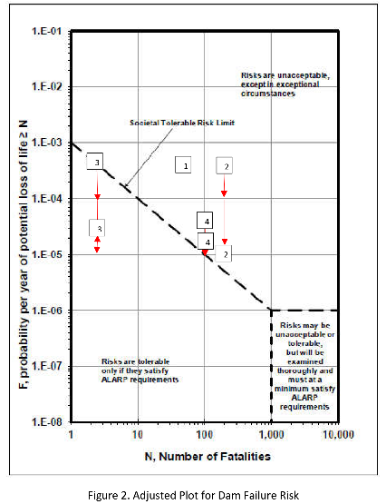
Risk Informed Prioritization (2)
In FY 2021 FEMA consulted with the Board
  Resulting in the addition of a risk matrix for HHPD eligibility during the initial application
  Using the NID condition assessment for the likelihood of failure
  And population at risk (PAR) for consequences
FEMA made the decision to define HHPD eligible dams consistent with FEMA P-1025
  Using condition assessment in lieu of probability and PAR in lieu of loss of life
  The tolerable risk line was generally maintained
Notes:
For the FY 2021 HHPD grants, FEMA consulted with the Board and this resulted in the use of a risk matrix to define eligible dams for grant funding.
After much debate, it was decided to us the NID condition assessment as a indicator of likelihood of failure and PAR as an indicator of consequences.
FEMA management made the decision to define the portion of the risk matrix considered unacceptable risk similar to FEMA publication P-1025

Slide 6
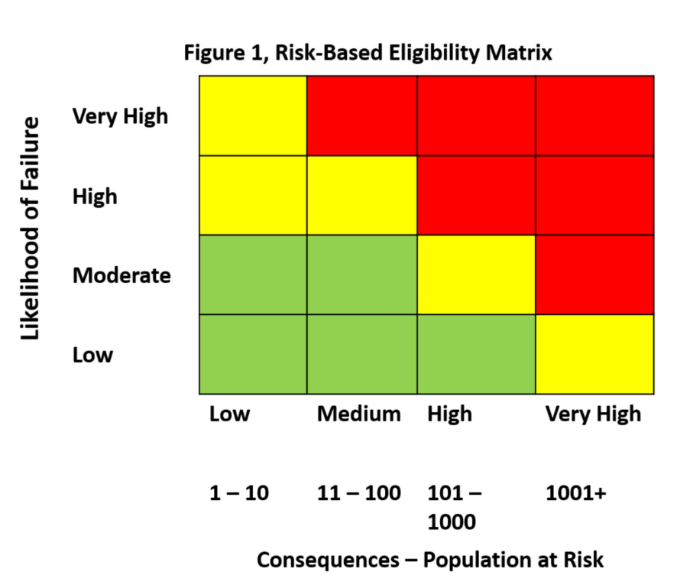
The Risk Eligibility Matrix
This matrix will only apply in FY 2021
The NDSRB and FEMA are collaborating on a new matrix to be used in future HHPD grant cycles starting in FY 2022
Likelihood of failure (vertical axis)
  From the latest NID condition assessment
  Likelihood of failure can not be from deferred operations and maintenance
Consequences (horizonal axis)
  PAR based on incremental risk of failure
Notes:
This risk matrix will only be used for the FY 2021 HHPD grants. The Risk-Based Eligibility Matrix defines the high hazard potential dams considered as unacceptable risk to the public.
The matrix will be reassessed for future grant cycles. The Board is collaborating with FEMA on a risk matrix for 2022 and beyond.
The risk matrix shown to the right uses the NID condition assessment for the likelihood of failure on the vertical axis
The risk matrix uses PAR to represent consequences on the horizonal axis
The grids in red are unacceptable risk to the public for the HHPD.

Slide 7

The Risk Eligibility Matrix (2)
Likelihood of failure (NID condition assessment)
Likelihood of Failure | NID Condition Assessment
Low | SATISFACTORY No existing or potential dam safety deficiencies are recognized. Acceptable performance is expected under all loading conditions (static, hydrologic, seismic) in accordance with the applicable regulatory criteria or tolerable risk guidelines.
Moderate | FAIR No existing dam safety deficiencies are recognized for normal loading conditions. Rare or extreme hydrologic and/or seismic events may result in a dam safety deficiency. Risk may be in the range to take further action.
High | POOR A dam safety deficiency is recognized for loading conditions which may realistically occur. Remedial action is necessary. POOR may also be used when uncertainties exist as to critical analysis parameters which identify a potential dam safety deficiency. Further investigations and studies are necessary.
Very High | UNSATISFACTORY A dam safety deficiency is recognized that requires immediate or emergency remedial action for problem resolution.
Notes:
The table to the left maps the NID condition assessment definitions to the ranges of likelihood of failure shown on the matrix. So:
Satisfactory is low likelihood
Fair is Moderate likelihood
Poor is high likelihood
Unsatisfactory is very high likelihood

Slide 8

The Risk Eligibility Matrix (3)
Consequences (PAR incremental risk)
Incremental Risk- The risk (likelihood and consequences) to the pool area and downstream floodplain occupants that can be attributed to the presence of the dam should the dam breach prior or subsequent to overtopping, or undergo component malfunction or misoperation, where the consequences considered are over and above those that would occur without dam breach.
Consequences | Population at Risk
Low | 1-10
Medium | 11-100
High | 101-1000
Very High | 1001+
Notes:
Consequences are estimated using the population at risk (PAR)
The table shows the ranges of PAR mapped to levels of consequences. So:
Low consequences is 1-10 PAR
Medium consequences is 11-100 PAR
High consequences is 101-1000 PAR
Very high consequences is PAR greater than 1000

Slide 9
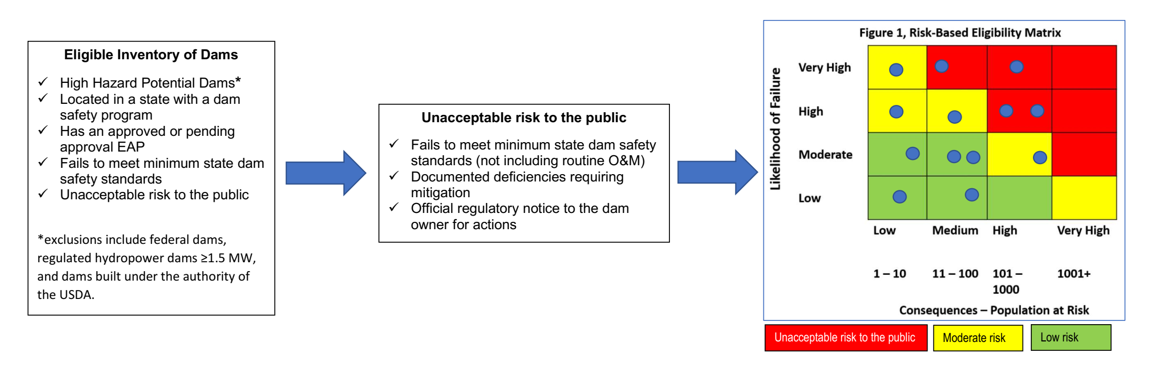
Risk-based Eligibility of Unacceptable Risk to the Public
How it Works- Screen eligibility from the NID • Evaluate the nature of the deficiencies • Develop documentation for official regulatory notice • Calculate PAR • Map to Matrix • RED boxes ID Eligible Dams
Notes:
The HHPD Act defined the universe of dams eligible under the HHPD. The box to the left highlights what is eligible and what is excluded.
A key element of the Act is the requirement to screen the universe of eligible dams for dams with identified deficiencies. The box in the center is where the definition landed for unacceptable risk to the public in consultation with the Board.
The risk matrix (t the right) addresses the risk prioritization requirement of the Act. Eligible dams that are unacceptable risk to the public are mapped to the risk matrix. The dams that fall in the red gridded cells are eligible dams for HHPD funding.
The blue dots illustrate the 4 dams are considered as the eligible unacceptable risk to the public dams. The 4 dams in yellow are of moderate risk and should be managed as such as the state dam safety program. The 5 dams in the green cells are considered low risk.

Slide 10
Estimation of the Population-at-Risk
FEMA minimum guidance for PAR estimation
  PAR must be calculated
  PAR is for incremental risk of dam failure
  FEMA may audit the PAR documentation
FEMA accepts many methods for PAR estimation including the following typical methods
  Using specialized dam breach software that estimate PAR
  Using GIS to overlay dam breach mapping to census block data
  Identifying structures in the dam breach inundation mapping area and applying population density per structure type
Notes:
A key element of the risk matrix that must be calculated, is the population at risk.
FEMA has defined very limited restriction on the calculation of PAR:
The PAR requires a calculation and documentation
The PAR must be for incremental risk that I will further discuss in a minute
And FEMA does not require submission of the documentation with the grant program but has the authority to audit at a later date
In addition FEMA accepts various methods for calculating PAR ranging from:
Using computer programs that calculate PAR
Using GIS and census block polygons
Aerial interpretation of PAR

Slide 11
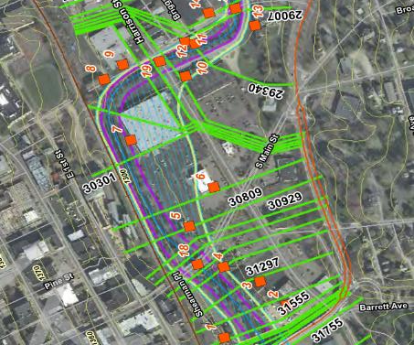
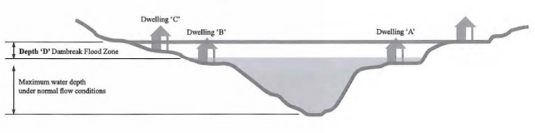
Estimation of the Population-at-Risk (2)
Determination of Incremental PAR
  The PAR directly attributable to the dam failure
  Varies by failure mode
Failure Mode | Dam Breach Mapping Inundation Mapping Scenario
Static Failure | Fair weather breach and failure at normal pool
Seismic Failure | Fair weather breach and failure at normal pool or at pool level based on site specific seismic study
Hydrologic Failure | The difference in the dam breach mapping areas with and without the dam failure at the spillway design flood
Hydrologic failure incremental PAR
Notes:
Incremental PAR is the population at risk directly attributable to a potential dam failure.
The table to the left shows the breach inundation mapping for each of the three general failure modes,
For instance static and seismic dam failures are assumed to occur during a normal loading condition represented by a fair weather sunny day breach at normal pool.
Hydrologic failures occur as the result of a rain event. The PAR representing incremental risk for the hydrologic failure mode is the PAR for the hydrologic event occurring over the watershed and with a breach during the event minus the PAR for the hydrologic event assuming the dam does not fail.
The cross section to the right illustrates the difference in flood height directly attributable to the dam breach.

Slide 12
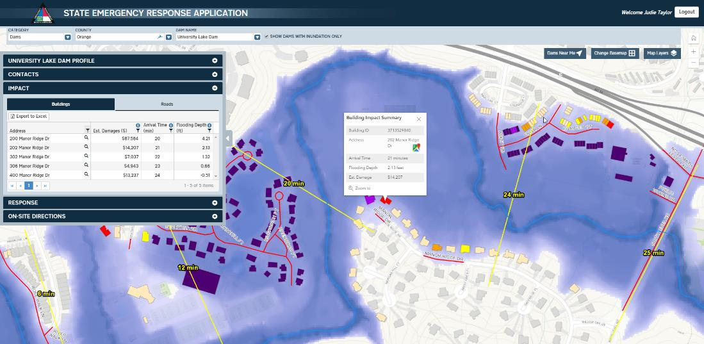
Estimation of the Population-at-Risk (3)
Determination of PAR using specialized software that can simulate dam breach events (examples)
  USACE HEC LifeSIM
  FEMA HAZUS
  DSS-WISE Lite
Image custody of ESP
Notes:
Several typical methods are available to estimate PAR.
One such method is to use a specialized software that can calculate PAR. I list three common methods including the:
USACE HEC-Life Sim
FEMA HAZUS
DSS-Wise Lite
The next few slides will provide additional details.

Slide 13
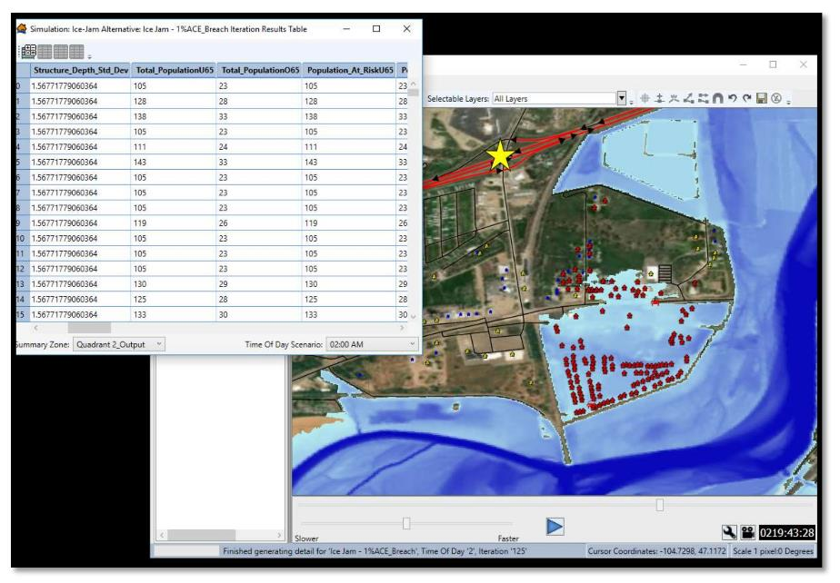
Estimation of the Population-at-Risk (4)
Determination of PAR using HEC- LifeSIM
  USACE dynamic simulation model
  Agent based to simulate the movement of people
  Assesses the flood risk based on flood severity
  Using building structure data
  Producing PAR and potential of life loss
Notes:
The USACE HEC-LifeSIM software was developed to calculate loss of life.

Slide 14
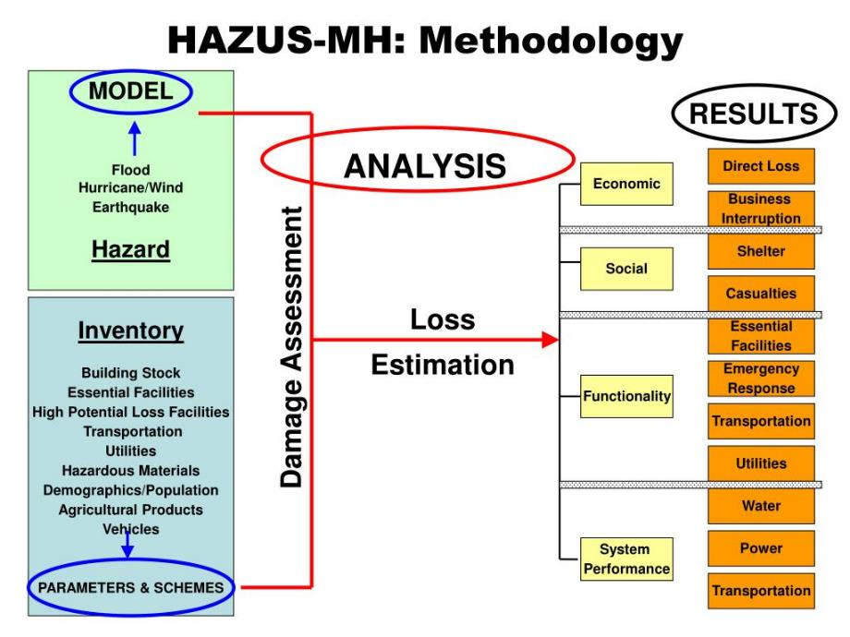
Estimation of the Population-at-Risk (5)
Determination of PAR from HAZUS
  Dam breach boundary can be imported in HAZUS
  Dasymetric census block data representing 2010 population can be exported for GIS estimation of PAR
Notes:
The FEMA HAZUS software can use a GIS map of the dam breach inundation area and using census block information in the tool produce PAR.
Or the Dasymetric census block data can be exported form HAZUS and used with the dam breach inundation area in GIS to calculate PAR.

Slide 15
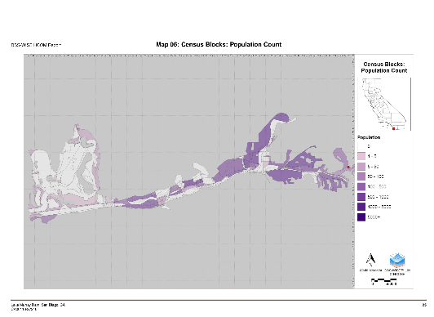
Estimation of the Population-at-Risk (6)
Determination of PAR using DSS-WISE Lite
ANALYSIS BASED ON CENSUS BLOCK DATA
  Flood severity method DV zones
  DSS-WISE HCOM module provides two
  different types of PAR analysis
    PAR Analysis using Census Block Population Data
    PAR Analysis Using LandScan USA Gridded Population Data
Population in completely or partially inundated census blocks: Housings in completely or partially inundated census blocks: Number of states in inundated area: Number of counties in inundated area: Number of census blocks in inundated area: ANALYSIS BASED ON GRIDDED LANDSCAN USA DATA | 23716 13214 1 1 248
Total Nighttime PAR in inundated area (see figure 2): | 4360
Total Daytime PAR in inundated area (see figure 3): | 20709
Notes:
Another method is to use the DSS-Wise Lite tool to calculate PAR using the HCOM model of the software.
DSS-Wise Lite is a quick and defendable method for computing fair weather sunny dam breach inundation maps that are used with the population data in the toolset provided by Oak Ridge National Laboratory.
The population data is included in ___ meter grid cells and the results should be carefully reviewed to avoid a overestimation of PAR.

Slide 16
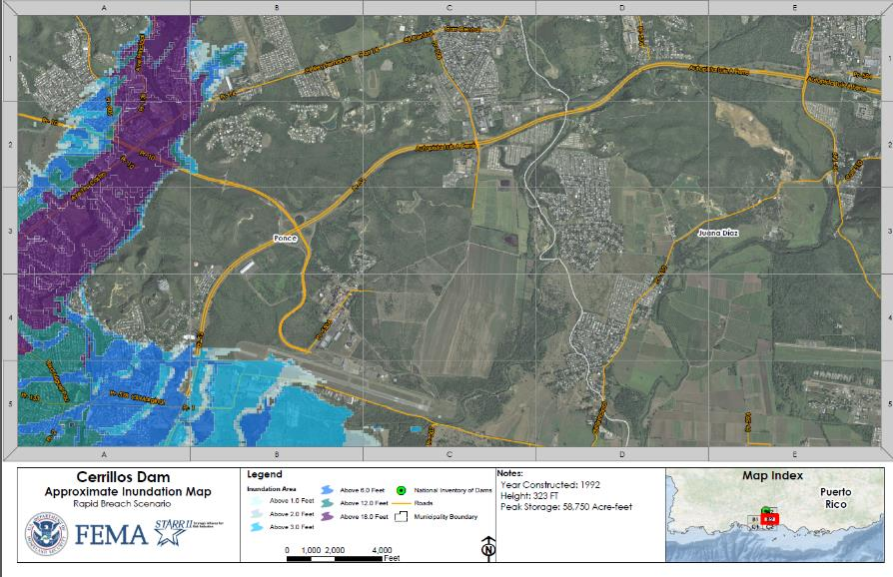
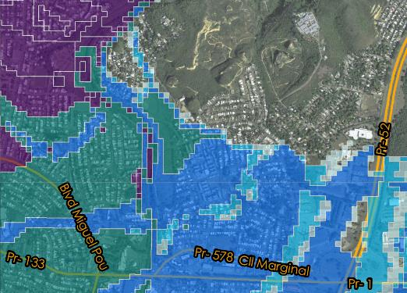
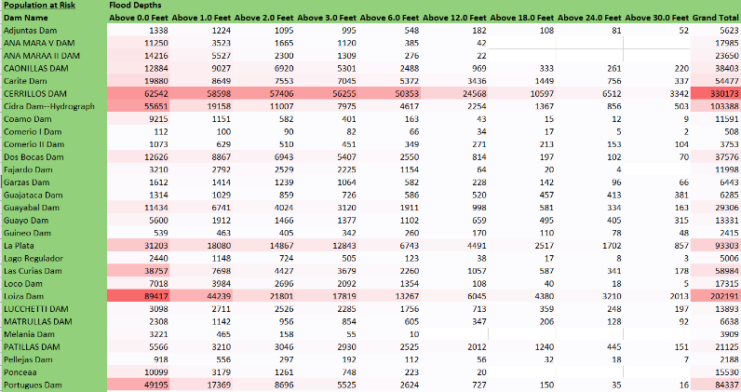
Estimation of the Population-at-Risk (7)
Using GIS to overlay dam breach mapping to census block data
  Overlay dam breach inundation mapping to census block polygons
  Using GIS apportion PAR to percentage of the polygon in the dam breach flood zone
Notes:
Another method for estimation of PAR is in GIS to overlay the dam breach inundation maps with the census block polygons.
The census block data is defines by physical features, population centers, political boundaries etc.
This may be a tight polygon is more urban areas and larger polygons in rural areas. Care should be taken to validate the results to avoid overestimation of PAR.
The map is a DSS-WISE Lite model run in Pietro Rico showing calculated PAR using census block data.

Slide 17
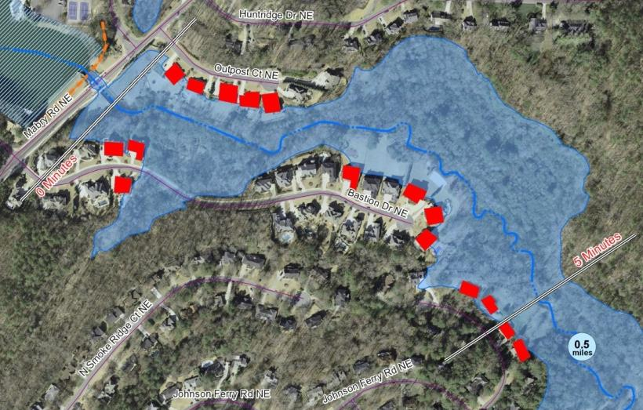
Estimation of the Population-at-Risk (8)
Inventory structures in the dam breach inundation mapping area and applying a population density per structure type
  Identify structure type
    Parcel/building data
    Building footprints GIS layers
    From aerial photographs
  For residential structures use 2.53 people per household (2020 census table HH-6)
  For other building types estimate population
    County records
    Available databases
    Parking spaces etc.
Notes:
Another method is to simply inventory the structures in the dam breach inundation mapping and to tabulate PAR by structure type.
Typically a value of 2.5 people per residential household is used. For non residential, local community building department, property assessment, and community GIS data and datasets are available to estimate PAR. I have seen parking lit spaces observed from aerial photographs to estimate PAR or number of units in apartment complex's for assigning a unit density,

Slide 18
Estimation of the Population-at-Risk (9)
Other Considerations
  Focus the PAR on building structures in the dam breach flood inundation zone
  Appropriate to include structures in proximity of inundation boundary to account for uncertainty
  PAR for primary roads can be considered using the procedures included in state dam safety guidelines
  PAR for seasonal or non-permanent population such as campgrounds are not to be used
  Use the higher of the PAR for any of the 3 failure modes
  The higher of day or night PAR may be used if available
  PAR should be rounded up to the next whole integer.

Slide 19
Questions

