Slide 1
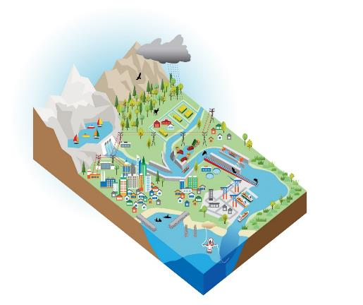
Civil Works Program - 2022 Appropriations
Recreation
Infrastructure Investment & Jobs Act: $17.1B
(signed into law 15 Nov 21)
FY22 Supplemental Appropriations: $5.7B
(Disaster Relief Supplementation Appropriations Act focused on Hurricane Ida)
FY22 Regular Appropriations: $6.7B - $8.7B
(pending Congressional action)
FY22 Appropriations:
approximately $30B
Navigation
Aquatic Ecosystem Restoration
Hydropower
Flood Risk Management
Regulatory

Slide 2
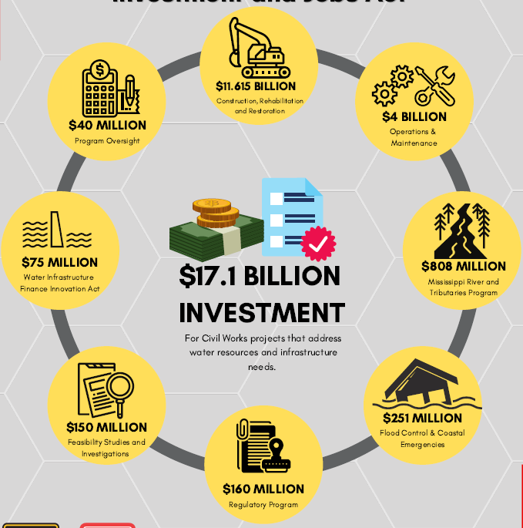
USACE Role in the IIJA MG Graham
Notes:
Grace Geiger/Dave Wethington/Jeff Anderson
This slide depicts the funding authorities provided by the recent Infrastructure Investment and Jobs Act. In short, 90% of this investment goes toward Construction and Operations & Maintenance. The remaining 10% is for our regulatory program, short term storm damages, and expenses.
[Walk through infographic]
Criteria for this Infrastructure funding:
Life/Safety
Legal Mandates
National Security
Environmental and Economic Returns
Finish what we start
Current USACE Construction Backlog
Funded but not completed 272 @ $48.6B
Authorized but not funded 406 @ $42.7B
Dam Safety 285 @ $18B
Total 963 @ $109B
90% of this money has no geographic limitations
$4B for O&M is Huge!
$2B – FY22; $1B – FY23; $1B – FY24
239 Locks & 715 Dams
15K miles of levees
577 new channels
#11.615B for Construction, Rehabilitation, & Restoration:
$1.5B - Rivers & Harbors
$2.5B – Inland Waterways
$1.98 – AER
$2.5B – CSRM
$2.5B - Inland Flood Risk Management
$75M for Water Infrastructure and Finance Innovation Act
Non-Federal Dam Safety,
Long-term/low interest loans (Total $7B in loans)
$150M for Feasibility Studies & Investigations – we have flexibility to move this into Programs or Regulatory
Also – tools like WRDA 22 is around the corner – Testimony before the House Transportation & Infrastructure Committee on January 12th. A couple of examples is Section 318 and regional Dredge Program.
NEXT SLIDE

Slide 3
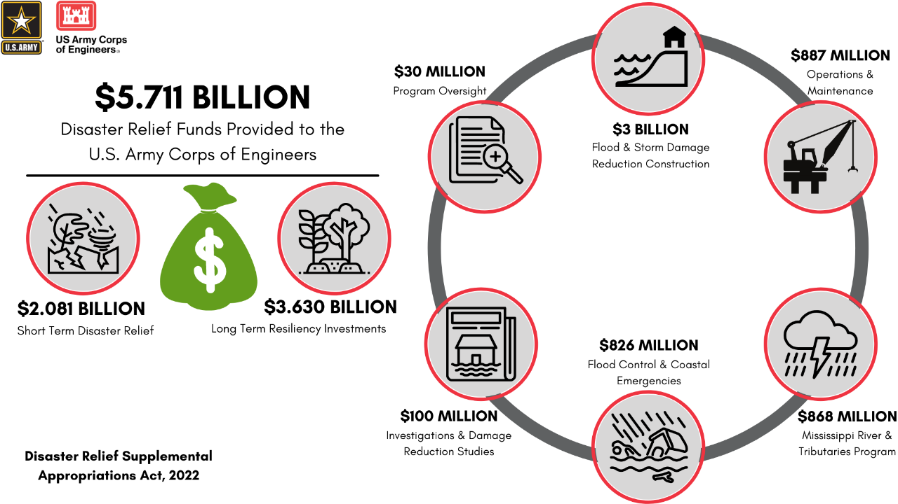
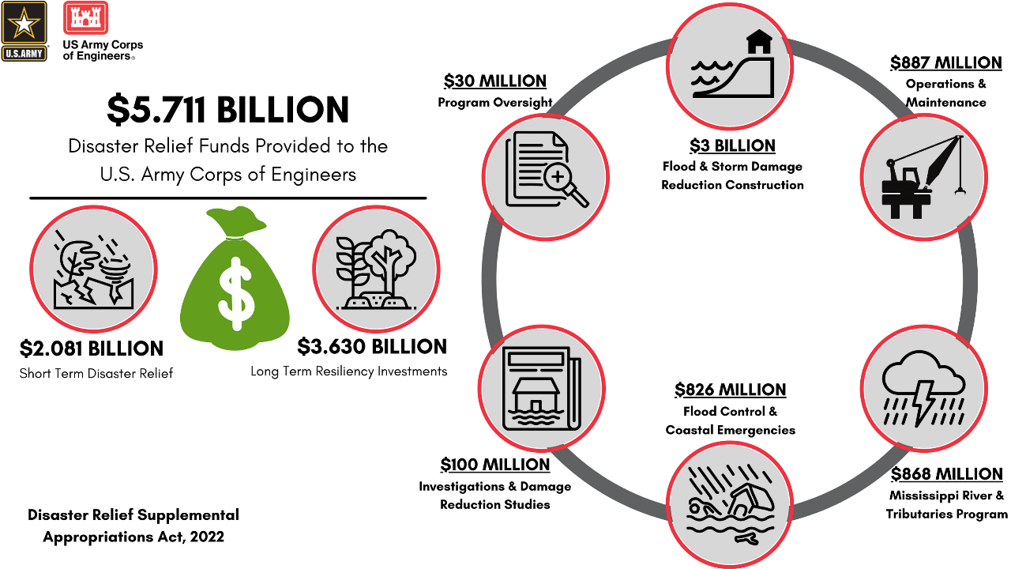
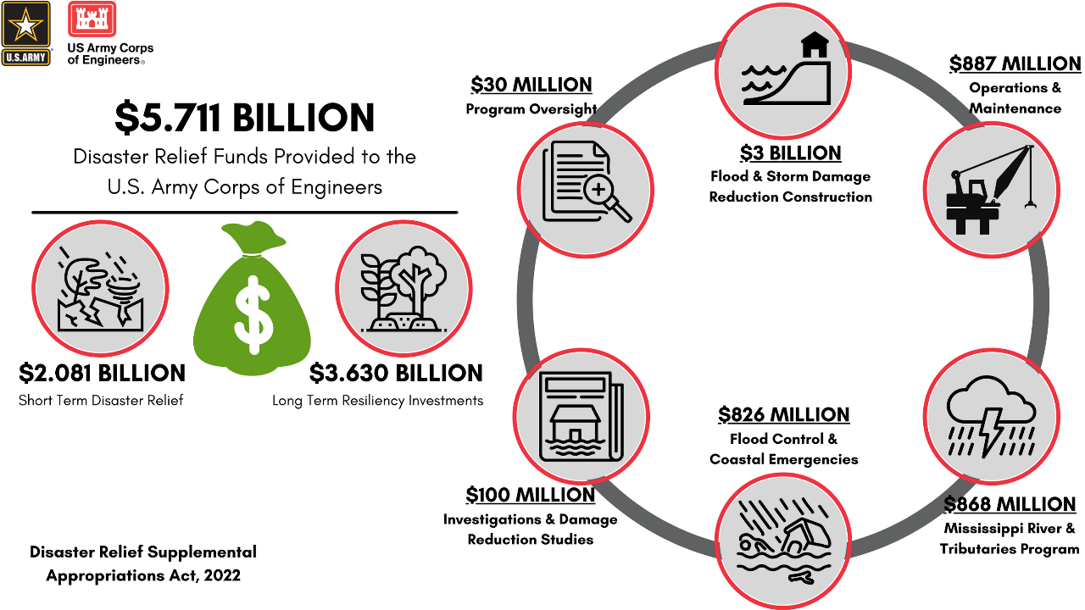
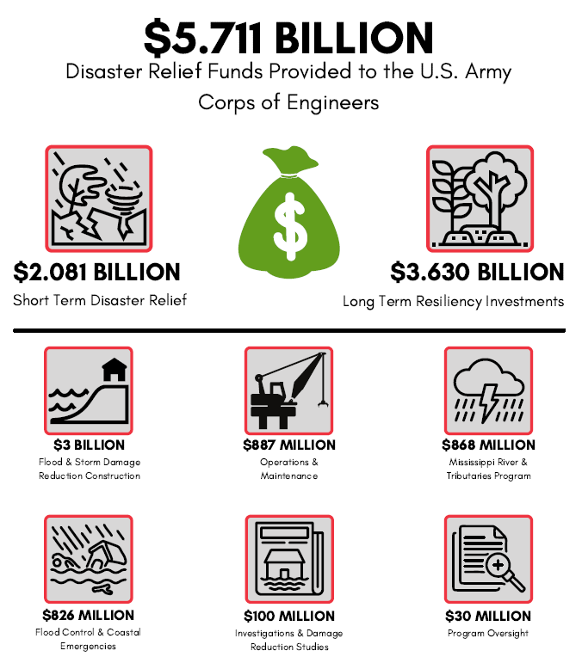
Disaster relief supplemental appropriations act, 2022
Notes:
Grace Geiger/Dave Wethington/Jeff Anderson
This year we received an additional $5.71 Billion for Disaster Relief Supplemental Appropriations after Hurricane Ida.
This chart depicts how those funds are broken down
Walk through INFOGRAPHIC – Highlight
$2B Short-Term Repairs;
$3.6B Long-term Construction (½ to LA, NY, PA, NJ & ½ Nation wide)
We have made our project recommendations to the Secretary and Administration, and they are currently being considered for funding in this bill, the IIJA, or the FY23 CW Budget.
NEXT SLIDE

