Slide 1
Post-Award High Hazard Potential Dams (FY22HHPD) Grant Program
Step 2:
Post-award: Scope of Work Package submission
National Dam Safety Program

Slide 2

Congratulations!
FY22 High Hazard Potential Dam (HHPD) Grant Awardees
Part 1: Eligibility and Completeness
FEMA approved State Hazard Mitigation Plan program includes ALL dam risk or is approved a 12-month extension to update the Plan.
Assurances
Eligible Dam list
State Administrative Plan; confirms:
  Internal capacity and controls
  Non-Disaster Grants Management System (ND Grants) portal system
  Timelines and milestones for implementing the HHPD grant.
  Process for selecting HH dam projects, subrecipients, monitoring projects.
  Quarterly reporting (program/project and financial)
  Sound project management and business practices
PART 1 - You passed GO !
Notes:
The State Administrative Plan (Pg 20 NOFO) must clearly describe the SAA’s timelines and milestones for implementing the HHPD grant. The State Administrative Plan must describe the process for selecting subrecipients.
State Administrative Plan.
At a minimum, the State Administrative Plan must include the items listed below:
Designation of the SAA responsible for program administration.
Identification of the State Official responsible for financial and program matters related to the High Hazard Potential Dam Rehabilitation Grant Program
Timely submission of HHPD quarterly performance progress reports on approved projects.
Determination of staffing requirements and sources of staff necessary for administration of the program.
If applicable, the establishment of procedures as a Pass-through Entity:
Identify, select, and notify potential subrecipients of the availability of the program.
Ensure that potential subrecipients are provided information on the application process, program eligibility, including the requirement for a FEMA-approved mitigation plan that includes all dam risks, and key deadlines.
Determine subrecipient eligibility, including the requirement for a FEMA-approved mitigation plan
Submit revisions or amendments for FEMA review and approval. See Section F.2, Pass-Through Requirements.
Conduct environmental and floodplain management reviews.
Establish priorities for selection of projects.
Process requests for advances of funds and reimbursement.
Monitor and evaluate the progress and completion of the selected projects.
Review and approve cost overruns.
Process appeals.
Provide technical assistance as required to subrecipient(s) including coordination with State Hazard Mitigation Officer regarding the eligibility requirement to have a FEMA-approved mitigation plan that includes all dam risks and complies with the Disaster Mitigation Act of 2000 (Public Law 106–390; 114 Stat. 1552). For more information on the Mitigation Plan Requirements, see Section E.1., Application Evaluation Criteria.
Comply with the administrative and audit requirements of 2 CFR parts 200 and 3002.

Slide 3
Agenda Overview
Guidance and Resources
State Grantee and Subrecipient Requirements
Approved Hazard Mitigation Plan Requirement
Grant Cycle and Project Management
Roles and Responsibilities
  Prime Grantee
  Sub-recipient/subaward
  FEMA Program Officer
Management of Subawards
Part-2: Scope of Work Package
  Planning and design projects (AA)
  Construction projects (IIJA)
  Environmental and Historic Preservation (EHP) Requirement
  Workplan/Excel
Quarterly Performance (Workplan /Milestone) and Financial Reporting
Floodplain Management Plan (FPMP)
Changes /Amendments and No Cost Extensions
Grant Close Out

Slide 4
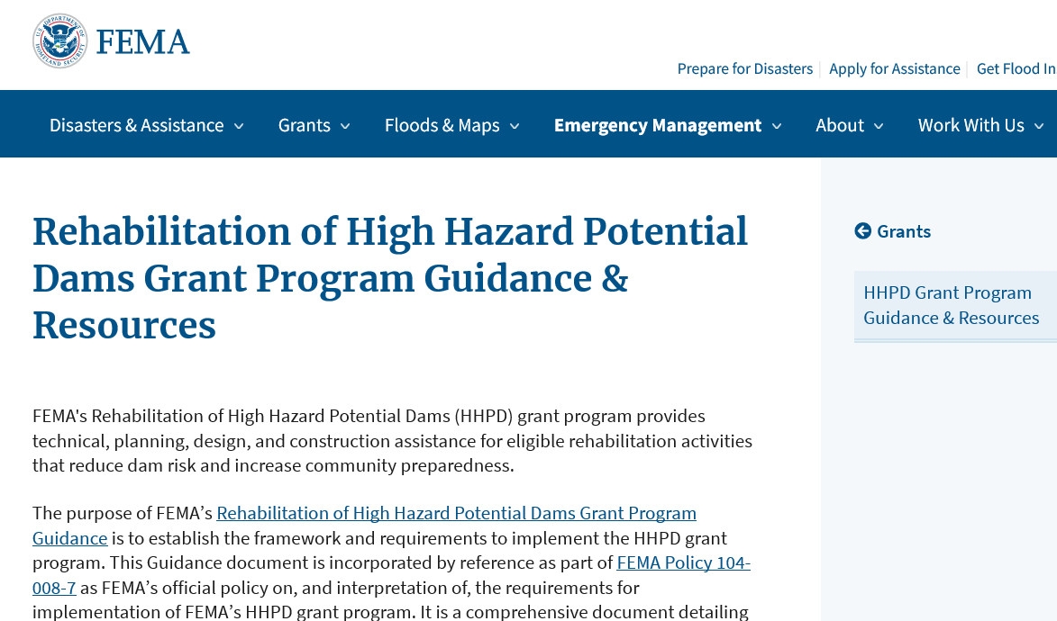
HHPD Grant Program Guidance & Resources, NOFO, 2 CFR 200
Fact sheets and Job Aids
Frequently Asked Questions
HHPD PPT 101 - PPT
HHPD Policy Guidance : Mitigation Planning Policy Updates | FEMA.gov
FY22 HHPD Notice of Funding Opportunity (NOFO)
2 CFR 200 :Uniform administrative requirements, cost principles, and audit requirements for federal award
Answers to most questions: https://www.fema.gov/emergency-managers/risk-management/dam-safety/grants/resources
Notes:
FEMA HHPD Guidance (pdf)
Application
Required Scope of Work package (aka amendment)
Eligible costs
Pass-through-entities
Subrecipients
Reporting requirements
And much more….
Rehabilitation of High Hazard Potential Dams, Grant Program Guidance, June 2020
https://www.fema.gov/sites/default/files/2020-08/fema_hhpd_grant-guidance.pdf
Rehabilitation of High Hazard Potential Dams Grant Program Guidance & Resources
https://www.fema.gov/emergency-managers/risk-management/dam-safety/grants/resources
2CFR 200
https://www.fema.gov/media-library-data/1444220925938-b1dbb4d55dbd50388e12d38e187775fa/200CFRAppendix508.pdf
Local Mitigation Planning Policy Guide (FP-206-21-0002, April 19, 2022);

Slide 5


Recipient - Subrecipient
Recipient/State Administrative Agency
Subrecipient
State *
Non-federal government (State* or Local government)
Non-profit
*The term “state” means each of the several states of the United States, the District of Columbia, the Commonwealth of Puerto Rico, the Virgin Islands, Guam, American Samoa, the Commonwealth of the Northern Mariana Islands, and any other territory or possession of the United States.
Non-federal agency could be state or local government, county or non-profit.
Recipient
Subrecipient
Notes:
The term “state dam safety agency” means a state agency that has regulatory authority over the safety of non-federal dams. (State Authorized Agency/SAA)
Subrecipient can be applicant or a subrecipient.

Slide 6







Recipient & Subrecipient Requirements
Participate in, and comply with, all applicable federal flood insurance programs.
Have a approved hazard mitigation plan that includes all dam risks.
Commit to provide operation and maintenance of the project for the 50-year period following completion of rehabilitation.
Acts in accordance with the state dam safety program.
Comply with the 42 CFR
Section 5196(j)(9) regarding labor and wage rates under contracts
Develop a floodplain management plan to reduce the impacts of future flood events in the area protected by the project.
Notes:
The HHPD legislation specified several requirements for recipients of the HHPD grants:
Participate in, and comply with, all applicable Federal flood insurance programs; this means they need to be in good standing with the NFIP, similar to FEMA’s HMA grants.
Have in place a hazard mitigation plan that includes all dam risks;
3. Comply with FEMA’s minimum eligibility requirements to ensure that each owner and operator of a dam in under a participating State dam safety program and that receives assistance under this section – (i) acts in accordance with the State dam safety program; and (ii) carries out activities relating to the public in the area around the dam in accordance with the hazard mitigation plan described in subparagraph and
The following are related to completion of a construction project:
Commit to provide operation and maintenance of the project for the 50-year period following completion of rehabilitation (or the expected life of the dam);
Commit to provide operation and maintenance of the project for the 50-year period following completion of rehabilitation (or the expected life of the dam) and provide assurance that the owner of the dam has developed and will carry out a plan for maintenance of the dam during the expected life of the dam. (See Section C.6, Maintenance of Effort (MOE) and D.3, Required Application Documents.)
Comply with the Code of Federal Regulation (CFR) 42 section 5196(j)(9) – All laborers and mechanics employed by contractors or subcontractors in the performance of construction work financed with the assistance of any contribution of federal funds made by the Administrator of FEMA shall be paid wages at rates not less than those prevailing on similar construction in the locality as determined by the U.S. Secretary of Labor;
Have a floodplain management plan in place to reduce the impacts of future flood events in the area protected by the project – or-demonstrate that it will be in place no later than two years after the date of completion of construction of the project.

Slide 7


Eligible Sub-applicants
STATE AGENCY
LOCAL GOVERNMENT
NON-PROFIT (NP)
Notes:
Subapplicants are the entity, such as a state or local government, non-profit (PNP), that submits a subapplication to the SAA for FEMA assistance.
Private, for-profit dam owners will need to work with their local government or State if they are interested in receiving funds for their dam.
Once funding is awarded, the subapplicant becomes the subrecipient, and receives a subaward.
A state agency can be the subapplicant.

Slide 8
Hazard Mitigation Planning
FEMA will determine if the mitigation plan addresses all dam risks in accordance with the requirements set forth in updated state and local mitigation planning policy (April 19, 2022)
APPLICANT ELIGIBILITY
State Mitigation Plan
Applicants (State Administrative Agency (SAA)) must have in place (by the application deadline and at the time of obligation of grant funds—when the grant is awarded) a FEMA-approved state hazard mitigation plan that includes all dam risks and complies with the Disaster Mitigation Act of 2000 (Public Law 106–390; 114 Stat. 1552).
SUBRECIPIENT ELIGIBILITY
Local or Tribal* Mitigation Plan
Subrecipients must demonstrate that the tribal or local government with jurisdiction over the area in which the dam is located has in place at the time the SAA submits the scope of work (SOW) package to FEMA, as well as the time FEMA approves the SOW package, a FEMA-approved hazard mitigation plan that includes all dam risks and complies with the Disaster Mitigation Act of 2000 (Public Law 106–390; 114 Stat. 1552).
* Note: Tribal governments are not eligible subrecipients but if the dam is located on Tribal land, the tribal plan must be approved by FEMA and include all dam risks.
Notes:
Mitigation Planning Policy Updates | FEMA.gov

Slide 9
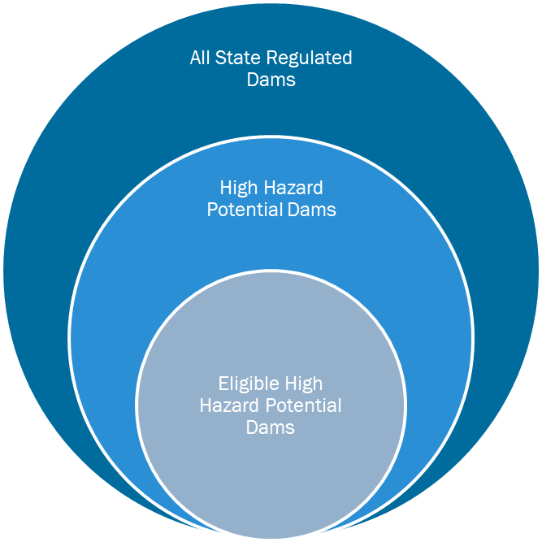
Key Questions: “All Dam Risk”
What Does “All Dam Risk” Mean?
Incremental Risk
Likelihood and consequences of a dam incident.
Can be initiated by 1) internal loads, 2) external loads, or 3) mis-operation, component failure or malfunction.
Non-Breach Risk
Risk in the reservoir pool area and affected downstream floodplain due to “normal” operation of dam.
Residual Risk
The risk that remains after all mitigation actions and risk reduction actions related to a specific dam safety issue have been completed.
Which Dams Should be in the Plan?
Notes:
At a minimum, include all “high hazards dams,” which references the subset of dams defined at 33 U.S.C. § 467(4)(A) as a non-Federal dam that
is located in a state with a state dam safety program;
is classified as “high hazard potential” by the state dam safety agency in the state in which the dam is located;
has an emergency action plan approved by the relevant state dam safety agency;
and the state in which the dam is located determines dams as HHPD that fail to meet minimum dam safety standards of the state;
and pose an unacceptable risk to the public.
FY22 NOFO: “All Dam Risk For the purposes of the HHPD program, all dam risk includes the incremental risk, non-breach risk, and residual risk associated with each eligible high hazard potential dam, as well as the reason(s) the state has determined the dam is an eligible high hazard potential dam.”
For the purpose of mitigation planning, addressing all dam risks in mitigation planning is accomplished by meeting the requirements set forth in the NOFO and state and local mitigation planning policies. It is done through the planning process, hazard identification and risk assessment, developing and updating goals, and developing and implementing the mitigation strategy. In the hazard identification and risk assessment, including all dam risks is done at a scale appropriate to the planning area and should include descriptions of incremental, breach, and non-breach risks as described in Section 5.8 of the Rehabilitation of High Hazard Potential Dams Grant Program Guidance (June 2020) FEMA Policy FP 104-008-7.

Slide 10
Hazard Mitigation Plan Requirements
Changes from FY20 – Local or Tribal Governments and Dam Location
The FY 2021 HHPD Grant Program Notice of Funding Opportunity (NOFO) introduces:
  Subrecipients must demonstrate that the tribal or local government with jurisdiction over the area in
  which the dam is located has a approved hazard mitigation plan that includes all dam risks.
Minimum Requirements
Does the plan describe the incorporation of existing plans, studies, reports, and technical information for high hazard potential dams?
Does the plan address high hazard potential dams in the risk assessment?
Does the plan include mitigation goals to reduce long-term vulnerabilities from high hazard potential dams?
Does the plan include and prioritize mitigation actions to reduce vulnerabilities from high hazard potential dams?
Notes:
This is a shift from FY20 to FY21 for subrecipients that are local governments, including special districts, as defined in 44 CFR §201.2 Definitions.
“Local government is any county, municipality, city, town, township, public authority, school district, special district, intrastate district, council of governments (regardless of whether the council of governments is incorporated as a nonprofit corporation under state law), regional or interstate government entity, or agency or instrumentality of a local government; any Indian tribe or authorized tribal organization, or Alaska Native village or organization; and any rural community, unincorporated town or village, or other public entity.”
Subrecipients must demonstrate that the tribal or local government with jurisdiction over the area in which the dam is located has an approved hazard mitigation plan that includes all dam risks.
FY20 HHPD Guidance (Policy)
Does the plan describe the incorporation of existing plans, studies, reports, and technical information for eligible high hazard potential dams?
Does the plan address eligible high hazard potential dams in the risk assessment?
Does the plan include mitigation goals to reduce long-term vulnerabilities from eligible high hazard potential dams? AND HHPD 3 / Does the plan include mitigation goals to reduce long-term vulnerabilities from high hazard potential dams that pose an unacceptable risk to the public?
Does the plan prioritize mitigation actions to reduce vulnerabilities from eligible high hazard potential dams?
FY21 NOFO
Does the plan describe the incorporation of existing plans, studies, reports, and technical information for eligible high hazard potential dams?
Does the plan address all dam risk from high hazard potential dams in the risk assessment?
Does the plan include mitigation goals to reduce long-term vulnerabilities from high hazard potential dams?
Does the plan include actions that address high hazard potential dams, and prioritize mitigation actions to reduce vulnerabilities from high hazard potential dams?

Slide 11



Mitigation Planning Resources
For more detail on minimum requirements and procedures, see:
FY 2021 HHPD Grant Program NOFO
Sections E. 1. a., Page 28, and H.11, Page 52.
FEMA Policy FP 104-008-7 Rehabilitation of High
Hazard Potential Dams
Grant Program Guidance
(June 2020)
Sections 5.8, page 5-28,
and 5.9, page 5-42.
Local Mitigation Plan Review Guide
(October 2011)
Guía de Revisión del Plan Local de Mitigación
(Octubre 2011)
Tribal Mitigation Plan Review Guide
(December 2017)
LEARN MORE
LEARN MORE
LEARN MORE
LEARN MORE
For the latest information, resources and tools, visit: Hazard Mitigation Planning | FEMA.gov

Slide 12
Request for Extension to Meet Plan Requirements
  The request must be submitted by the HHPD grant Recipient to FEMA in the Non-Disaster Grants Management System (ND Grants) and include a written justification that identifies:
The circumstance for not meeting the mitigation plan requirement;
Explains what resources the recipient and/or subrecipient will use to update the FEMA-approved mitigation plan; and
The schedule and milestones for the plan to be developed and approved by FEMA within twelve (12) months of the date FEMA approves the recipient grant scope of work (SOW) package.
EXTRAORDINARY CIRCUMSTANCE
If the Applicant or Local or Tribal Government where the dam is located does not have a mitigation plan that includes all dam risks, the Applicant may request a 12-month extension to meet this requirement in coordination with the Local or Tribal Government.
Notes:
FY 2022 HHPD Grant Program Notice of Funding Opportunity (NOFO), Section H.13, page 52.

Slide 13
Mitigation Planning Contacts
The following resources are available if you still have questions or need technical assistance and training on mitigation planning:
Note: Applicants must coordinate between the State Dam Safety Office (or its equivalent) and the State Hazard Mitigation Officer and/or State Mitigation Planner
Senior Regional Mitigation Planner in your FEMA regional office
HHPD Helpline FEMA-NDSP-HHPD@fema.dhs.gov

Slide 14
Post-award Grant Cycle and Project Management
PART-2
Scope of Work Package (SOW) Submission and Review
Project Management
Project POC/Lead
Award Determinations and Obligation
Final Award Determinations
Develop Award Package
Recipient Notification of Award
Federal Funding Obligated in the Financial System
Quarterly Reporting and Close Out
Project Workplan
Schedule of milestones
Sub-recipient selection and eligibility /checklist
Budget detail
FEMA SOW review process and approval
Project team coordination
Record keeping and documentation
Draw-down funds
Submission of required quarterly reports (program and financial)
Standard and required information reporting
Close out process; final report
Align with performance metrics
ND Grants
Period of Performance established
Amendments/extensions
Environmental and Historic Preservation (EHP) checklist
Eligible Dam and Hazard Mitigation Plan

Slide 15
Roles and Responsibilities
State Authorized Agency: FY22 HHPD Recipient
Access tools, job aids to successfully interface with ND Grants Portal (official system of record)
Adhere to terms and conditions of award; program-specific regulations;
  federal administrative requirements and cost principles; and program policy and guidance. (2 CFR Part 200)
Responsible for the day-to-day management of FEMA approved project
Successful completion of project/s and management of subrecipients
Maintain strong internal controls
Notes:
Capability and Capacity
2 CFR Part 200 - UNIFORM ADMINISTRATIVE REQUIREMENTS, COST PRINCIPLES, AND AUDIT REQUIREMENTS FOR FEDERAL AWARDS
Ref: State Admin Plan (SAA Responsibilities)
Includes:
Methodology and data used to measure progress toward achieving the performance outcomes of the HHPD grant.
Timely submission of HHPD quarterly performance progress reports on approved projects.
Determination of staffing requirements and sources of staff necessary for administration of the program.
Conduct environmental and floodplain management reviews.

Slide 16
Roles and Responsibilities: Pass-through Entity (awarding to subrecipients)
  Monitor activities of the subrecipient to ensure subaward is used for authorized purposes
  Ensure subrecipients are provided information on key deadlines and reporting requirements; provide technical assistance as needed
  Receive and review quarterly financial and programmatic reports
      **Separately track IIJA construction ready investments (program and financial)
  Coordinate environmental planning and historic preservation project reviews with FEMA
  Process requests for advances of funds and reimbursement
  Review and flag potential cost overruns
  Process appeals
  Provide quarterly progress reports to FEMA on approved subaward projects
  Comply with close-out requirements and final report
Notes:
Conduct program and financial monitoring activities:
Verify though audit or other on-site review is being performed pursuant to the Uniform Guidance.
Maintains program documentation and scope / task invoice for payments and require the subrecipient submit adequately detailed costs

Slide 17
Roles and Responsibilities: Pass-through Entities
2 CFR 200.331
  Verify and document the following information at the time of the subaward
  Evaluate each subrecipient’s risk of noncompliance with federal statutes, regulations, and the terms and conditions of the subaward.
  Consider imposing specific subaward conditions upon a subrecipient if appropriate as described in § 200.207 Specific conditions.
  Ensure every subaward is clearly identified to the subrecipient as a subaward and includes information required in 2 CFR Section 200.331.
  Ensure proper accountability and compliance with program requirements and achievement of performance goals
Notes:
The subaward terms must be communicated to the subrecipient, including the requirement for a FEMA-approved mitigation plan that includes all dam risks (See HHPD Guidance Appendix B, Definitions, for the definition of all dam risk and Section 5.8.3, Mitigation Plan Requirements for Subrecipients (Local Governments or Nonprofit Organizations), for more information).
The maximum amount of funding any Subrecipient can receive under HHPD is statutorily limited. The maximum subrecipient funding cannot exceed the lesser of 12.5 percent of the total amount of funds made available, or $7,500,000

Slide 18
Roles and Responsibilities:
Pass-through Entities (con’t)
Follow-up and ensure subrecipient takes prompt and appropriate action for any deficiencies discovered through audits, on-site reviews, and other monitoring activity.
Consider whether the results of the subrecipient's audits, on-site reviews, or other monitoring indicate conditions that necessitate adjustments to the pass-through entity's own records.
Consider taking enforcement action against noncompliant subrecipients as described in § 200.338 Remedies for noncompliance of this part and in program regulations.
Issuing a management decision for audit findings as required by 2 CFR Section 200.521.
Notes:
All pass-through entities must comply with 2 C.F.R. 200.332 Requirements for pass-through entities.

Slide 19
Roles and Responsibilities Subrecipient
Must include a financial plan that demonstrates enough funds are available to implement the Operations and Maintenance (O&M) activities described in the O&M Plan.
The O&M Financial Plan may be attached to or incorporated into the O&M Plan. (See Page 37 HHPD-G)
Required to provide an O&M Agreement demonstrating their commitment to providing O&M of the project for the 50-year period (or the expected life of the dam) following completion of rehabilitation.

Slide 20
Roles and Responsibilities: Subrecipient (cont.)
4. Adhere to terms and conditions of agreement; program-specific regulations; federal administrative requirements and cost principles; and program policy and guidance
5. Implementation and management and completion of state approved project received by the pass-through entity
6. Comply with the budget and timeline contained in the approved project scope
7. Maintain strong internal controls
8. Submission of progress and financial reports to State Administrative Agency

Slide 21
Roles and Responsibilities: FEMA Program Officer
Provide technical guidance to State Administrative Agency
Review and monitor State Administrative Agency progress
Review and approve Scope of Work Package requests and troubleshoot
Provide oversight and monitor the performance of the grant by the grantee.
Track, collect, and report on IIJA investments
Ensure program goals are accomplished in conformance with Federal grant guidelines
Ensure State Administrative Agency compliance with 2 CFR Part 200 - Uniform Administrative Requirements, Cost Principles, And Audit Requirements For Federal Awards

Slide 22
Part 2: Next Steps and Scope of Work Requirements

Slide 23
Award Acceptance
60-day “acceptance "period begins when award notification is posted in ND Grants.
ND Grants task: Award offer review
Submit acceptance in ND Grants
Notes:
Recipients must accept their awards no later than 60 days from the award date. The recipient shall notify FEMA of its intent to accept and proceed with work under the award or provide a notice of intent to decline through the ND Grants system
ND Grants: 2021 Grant Recipient User Guide (fema.gov)
Accepting or Declining an Award
Once an application is awarded by FEMA, ND Grants will generate a task for accepting the award. To review an award, navigate to the Grants Dashboard page, which lists all applications submitted for your organization in ND Grants. Any applications awaiting acceptance will feature the Complete Award Offer Review icon in the Action column on the grants dashboard. To proceed further, the award package must be accepted. If necessary, users can decline the award package. Only a user with the Authorized Official role for the grant can accept or decline an award. The user that submits the application will automatically be assigned the Authorized Official role.

Slide 24
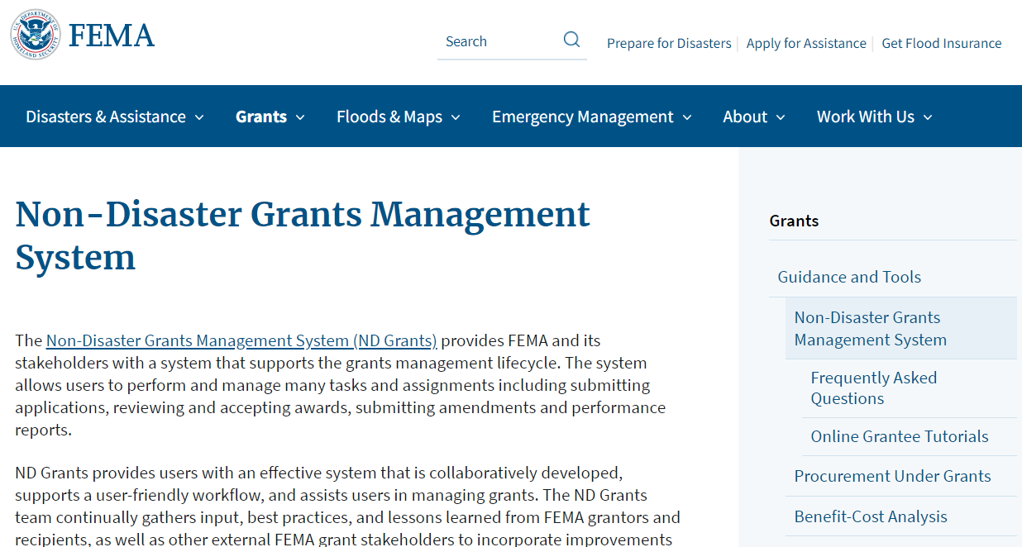
System of Records: ND Grants
ND Grants System Technical Assistance:
  Email: ndgrants@fema.dhs.gov
  Phone: (800) 865-4076

Slide 25
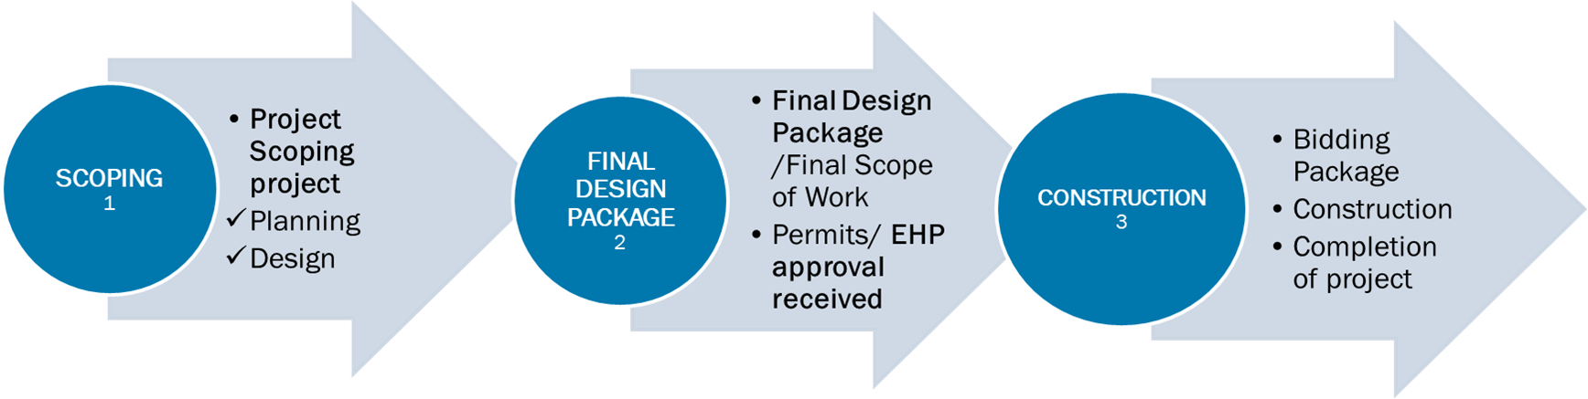
Part-2
Projects must be approved by the relevant state dam safety agency
Annual Appropriation Funding
IIJA Funding
SOW (scoping and final design) Package by Dec 31, 2022
SOW Construction Ready Package by Jan 20, 2023
Upload into ND Grant for FEMA review and approval
Notes:
FY22 HHPD Application
PART 1 – COMPLETED
_______________________________________________
PART-2 – SCOPE OF WORK PACKAGE
** Mitigation plan requirement for the jurisdiction where the dam is located
PHASE 1: Project Scoping: (preconstruction)
Planning activities include:
Public participation in dam project planning
Public education and awareness of flood risks associated with dam project
Identifying project specific data needs
Permits and compliance preparation
Potential approaches/alternatives analysis
Feasibility studies
Preliminary engineering studies
Onsite evaluations
Environmental impacts and consequences analysis
Mapping, engineering survey, and
inundation modeling
Preferred alternative
Coordination of EAP and EOPs for different release conditions and scenarios with dam rehab / removal project
Development of Floodplain Management Plan
Design
Design Stages
Data collection, analysis, and evaluation
Preliminary design (cost studies and feasibility, economic comparison of alternative design, comparative cost design studies, hydraulic design, foundation conditions)
Impacts to floodplain
Alternatives to avoid adverse effects to floodplains
Final Design
Design report (assumptions, construction drawings, specifications, operations and maintenance plan, estimate construction budget/costs/timeline)
Letter of Map revision (LOMR) 44CFR 65.12
Design Codes and standards
PHASE 2 : Final Detailed Scope, includes:
Project implementation
Problem/solution/methods
Scope summarized/narrative
Permits required / obtained - all state, local, and federal permits for approval to construct the project in the floodplain
Project schedule
Site plan
Construction drawings
HH Analysis
Budget
Finding of no significant impact FONSI or EIS
PHASE 3: Construction/Project Management (IIJA funded)
Rehab/decommission

Slide 26
FY22 HHPD Eligible Project Activities
  Eligible activities :
  1. PROJECT SCOPING:
  Planning
  Design
  2. FINAL DESIGN PACKAGE
  EHP approval, etc.
3. CONSTRUCTION (IIJA funded)
  Ineligible activities include:
  Rehabilitation of a federal dam
  Routine operation or maintenance
  Modification to produce hydroelectric power
  Increasing storage capacity
  Any other modification to a dam that does reduce risk and improve the safety of the dam

Slide 27
Scope of Work Package Requirements
Standard format and grant information
Project dam/s that meet selection eligibility
Workplans (Continuation HHPD project?)
Project scheduled /Quarterly milestones
Budget
Budget detail and cost share sources
Project narrative with performance metric
EHP checklist and supporting documentation
Verification of approved Hazard Mitigation Plan that includes all dam risk (dam locality)
Notes:
BEST PRACTICE format/ grant data elements
Grantee explain how the costs relate to the programmatic goals for the project; support the budget by showing the basis of computation.
FEMA to share SOW Package format and required information document

Slide 28
Environmental and Historic Preservation (EHP) Review
All projects funded with Federal grant dollars must comply with EHP laws, regulations and Executive Orders
EHP review begins when FEMA receives the post-award amendment with scopes of work
EHP review must be completed by FEMA National Dam Safety Program before project initiation even if a previous award/year/project has an approved EHP review
EHP reviews are conducted by FEMA EHP staff and may require additional coordination and information-sharing between FEMA and the grant recipient
FEMA documents EHP review in a Record of Environmental Consideration (REC)
  Includes an itemized list of project conditions
Notes:
All inquiries and communications about EHP compliance for FEMA grant projects under this NOFO or the EHP review process should be sent to FEMA-OEHP-NOFOQuestions@fema.dhs.gov

Slide 29
What are EHP Considerations?
  Floodplains
  Wetlands
  Cultural Resources
    Historic properties
    Archaeological sites
  Endangered Species
  Air and Water Quality
  Noise
  Fish and Wildlife Agricultural Lands
  Environmental Justice
  Socioeconomic Resources
  Land Use
  Hazardous Materials
  Traffic
  Geology (topography, soils)

Slide 30
EHP Review Information Needs
What are you proposing to do? Describe the scope of work.
Where is the project located?
  GPS points
  Maps, aerial photos, Google Earth files (Labeled, ground-level photos of project area)
Ground disturbance? (such as geotechnical investigations, collecting soil samples, cone penetrometer tests, etc.)
  Provide the location(s) of ground disturbance on a map (length, width, depth)
  Describe existing conditions
  Age of the dam
Other pertinent EHP information (environmental studies/surveys, permits, etc.)
Notes:
Clear description of the project
Project location- address or latitude/longitude
Labeled, ground-level photos of project area
Maps
Construction dates for any buildings/structures (including dams) in the project
Extent (length, width, depth) of all ground disturbance
Other pertinent EHP information (environmental studies/surveys, permits, etc.)

Slide 31
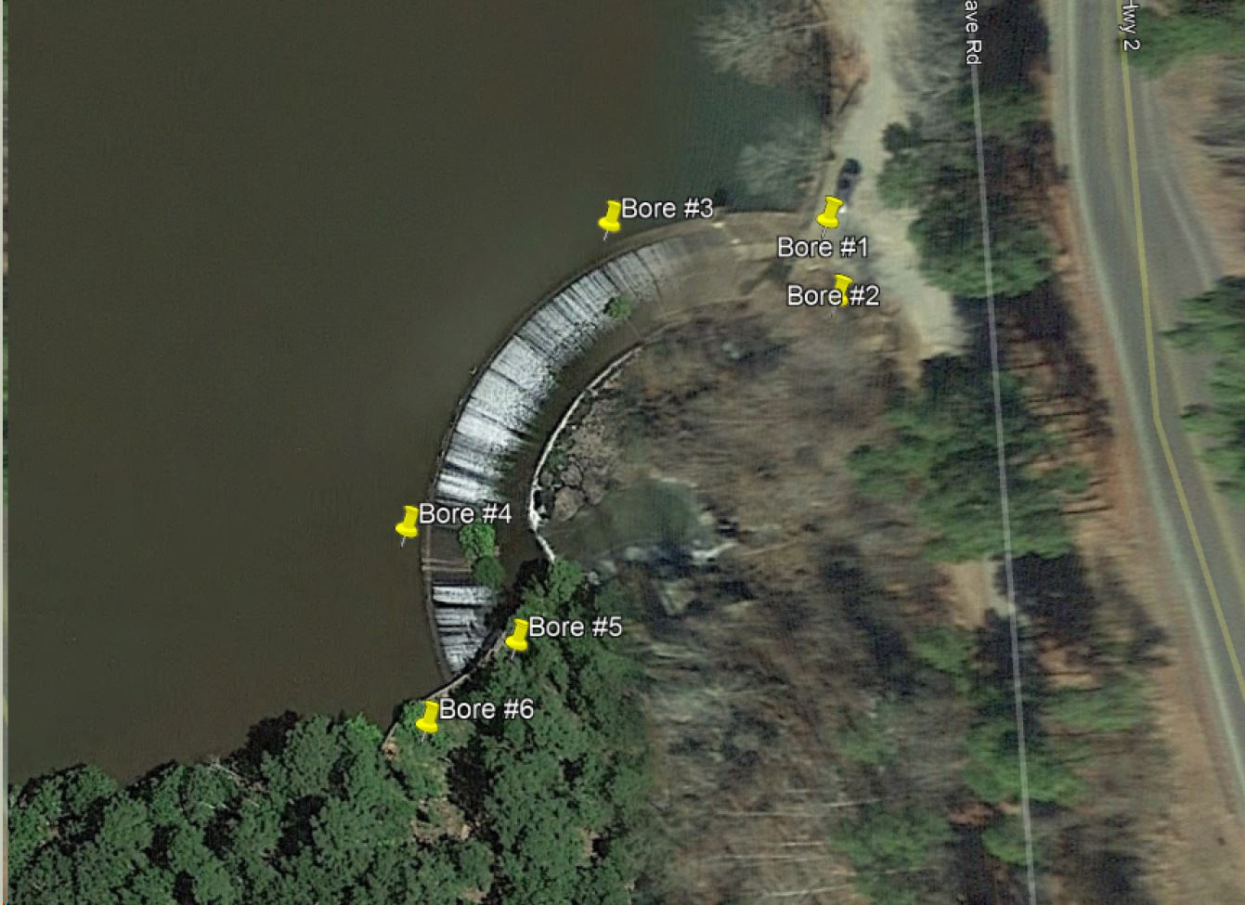
Scope of work Detail - Example
Ground disturbance will be geotechnical borings at/near the dam. Borings will be. 6” diameter, to a depth of 5 feet into bedrock. The anticipated boring locations for the dam are shown in the figure.

Slide 32
What may be required for EHP review?
May require preparation of written analyses or agreements under EHP laws, including:
  Environmental Assessments (NEPA)
  Biological Assessments (Endangered Species Act)
  Memorandum of Agreement (National Historic Preservation Act)
May require consultation with resource and regulatory agencies, including:
  State Historic Preservation Offices
  Tribal Governments
  US Fish and Wildlife Services
  US Army Corps of Engineers
Some EHP laws require public involvement and a public comment period
Notes:
NOTE: EHP review for projects with ground disturbance can take time (6-12 months)

Slide 33
EHP During Project Design
Early consideration of EHP requirements during project design will help identify potential adverse impacts to resources and environmental justice communities and allow corresponding avoidance or minimization measures to be incorporated into project design
Activities might include:
  Document alternatives to the proposed project
  Public engagement and notification
  Coordinate with regulatory and permitting agencies
  Identify environmental and cultural resources, and low-income or minority populations or tribes that may be impacted by the proposed project

Slide 34
Quarterly Performance Progress Reports
Standard data elements and reporting (template / example available)
Significant activities and developments that have occurred or have shown progress during the quarter, including a comparison of actual accomplishments to the work schedule objectives established in the subaward.
Percent completion and whether completion of work is on schedule; a discussion of any problems, delays, or adverse conditions that will impair the ability to meet the timelines stated in the subaward; and anticipated completion date.
  Construction-ready IIJA quarterly reporting
Status of costs, including whether the costs are (1) unchanged, (2) overrun, or (3) underrun. If there is a change in cost status, the report should include a narrative describing the change. Also, include amount dispersed to subrecipient by activity.
A statement of whether a request to extend the award Period of Performance is anticipated.
Funds expended
*** Additional information as required by FEMA to assess the progress of an award.
Notes:
Performance progress reports should be submitted as either a Microsoft Word document or as a PDF file.
Performance progress reports are due within 30 days after the end of each reporting period, and must be submitted via ND Grants
The recipient must submit a quarterly performance progress report (if using SF-PPR – must submitted additional required info) for each award.
Performance reports should include:
Reporting period, date of report, and recipient point of contact name and contact information.
Reports must be submitted via ND Grants
Project identification information, including FEMA project number, subrecipient, and project type using standard ND Grants/NEMIS project type codes.
FEMA may suspend drawdowns from SMARTLINK or PARS if quarterly performance progress reports are not submitted on time.

Slide 35
Best Practice/ Standards for Program Reporting
I. Agreement Information/data elements:
Period of Performance (POP): (start and end dates)
HHPD Grantee Organization Name:
HHPD Program Point of Contact info: (Name, address, phone, email)
Complete if you are managing a subaward: N/A
  Name/county of subaward organization:
  Project title/brief description:
  Amount awarded:
Date of Quarterly Report Submission:
Quarter: (Q1 Sept-Dec 2022)
Person (name) completing report:
Date submitted in ND Grants:
HHPD Award #:
HHPD Grant $: (Fed Amount Awarded) $
HHPD Grant match (35%): $
HHPD Grant $: (Draw Down to Date) (AA & IIJA) $
% of cost Share expended: $

Slide 36
Required information and Standards for Quarterly Program Reporting
II. Did you or (subaward) accomplish workplan targets for the quarter?
Indicate: Yes/No If no, explain:
III. Quarterly Milestone Deliverables (FY21):
Did you submit/include your Quarterly Milestones Report/ table this quarter with this quarterly report? (Excel Table/FEMA template)
Indicate: Yes/No
IV. Do you anticipate an amendment request within the next quarter (budget, scope) or POP Extension:
Indicate: Yes/No If yes, explain:
V. Additional narrative: (share successes, challenges, etc.)
VI. Additional documents/products attached?
Indicate: Yes/No If yes, please name document/s attached:
Notes:
FEMA to share required template and job aid

Slide 37
Floodplain Management Plan / FPMP
(not to be confused with NFIP – Flood Plain Ordinance)
Develop: no later than 2 years after the date of execution of a dam rehabilitation or removal project agreement (FINAL DESIGN – EHP approval received)
Implement: no later than 2 years after the date of completion of a project
Process: formalized stakeholder involvement and input from leading to adoption of the FPMP by the governing body impacted by the dam rehabilitation project.
Intent:
  Reduce the impacts of future flood events in the area impacted by the project.
  Functions as a stand-alone plan that does not modify the floodplain ordinance in effect to comply with the NFIP.
  FPMP includes
  Plan for flood fighting and evacuation
  Public Education and awareness of Flood Risk
Notes:
Rehabilitation of High Hazard Potential Dams Grant Program Guidance & Resources | FEMA.gov

Slide 38
Performance Metrics
Performance will be evaluated on the following outcomes:
1.1 Planning tasks and activities, studies and analysis for pre-construction phases, scoping activities, and permit applications.
1.1: Number of eligible HHPD dams that have resulted in the completion of studies and analysis for pre-construction phases, scoping activities, and permit applications.
1.2 Preliminary and final design package and required permit approvals.
1.2: Number of eligible HHPD dams that have resulted in the completion of preliminary and final engineering design package and permits.
1.3 Construction activities that support dam rehabilitation or removal projects.
1.3: Number of eligible HHPD dams that result in construction projects for dam rehabilitation or removal
Notes:
NOFO Page 5

Slide 39
Amendments /Extensions
Formal written request to FEMA/ Federal Insurance and Mitigation Administration, Risk Management Directorate
4 types of changes:
  SOW
  Budget
  Project management
  Extensions
Extension requests must contain specific and compelling justification as to why an extension is required.
Notes:
Extensions to the initial period of performance identified in the award will be considered only through formal, written requests to the FEMA/ Federal Insurance and Mitigation Administration, Risk Management Directorate and must contain specific and compelling justifications as to why an extension is required.
States are advised to coordinate with the FEMA Federal Insurance and Mitigation Administration, Risk Management Directorate as needed, when preparing an extension. All extension requests must address the following:
Grant Program, Grant Year, and award number;
Reason for delay – this must include details of the legal, policy, or operational challenges being experienced that prevent the final outlay of awarded funds by the applicable deadline. The reason must also be of significant extenuating circumstances (e.g. local flooding disaster);
Current status of the activity/activities;
Approved period of performance termination date and new project completion date (New recommended PoP);
Amount of funds drawn down to date;
Remaining available funds;
Revised delineated budget outlining how remaining Federal grant funds will be expended by approved task;
Plan for completion including milestones and timeframes for achieving each milestone and the position/person responsible for implementing the plan for completion; and
Certification that the activity/activities will be completed within the extended period of performance without any modification to the original Statement of Work approved by FEMA.
Applicants must submit extension request within sixty (60) calendar days prior to the period of performance end date, through ND Grants system for review by the FEMA National Dam Safety Office for final review and Amendment approval consideration. Extension requests must meet the Extensions requirements as listed above.

Slide 40
Regional Program Officers
Region | Contact
1 | Robert “Bob” Maclean robert.maclean@fema.dhs.gov
2 | Stephanie Gootman stephanie.gootman@fema.dhs.gov
3 | Hani Rimawi hani.rimawi@fema.dhs.gov
4 | Katy Goolsby-Brown katy.goolsby-brown@fema.dhs.gov John “Bud” Plisich john.plisich@fema.dhs.gov
5 | Daniel “Dan” Ryan daniel.p.ryan@fema.dhs.gov
Region | Contact
6 | Bart Moore bart.moore@fema.dhs.gov
7 | Dawn Livingston dawn.livingston@fema.dhs.gov
8 | Jamie Prochno jamie.prochno@fema.dhs.gov
9 | Joseph Johnson joseph.johnson@fema.dhs.gov Scott Nielsen scott.nielsen@fema.dhs.gov
10 | Dwight “Ted” Perkins dwight.perkins@fema.dhs.gov

Slide 41
DHS Awarding Agency HHPD Program Contact Information
The DHS/FEMA Federal Insurance and Mitigation Administration, Risk Management Directorate will manage, administer, and conduct application and budget review, create the award package, approve, amend and close out awards, as well as conduct audit resolution for the HHPD grants.
For Program Questions contact the National Dam Safety Program staff listed below:
Jenai Jordan
National Dam Safety Program
Federal Emergency Management Agency
Jenai.jordan@fema.dhs.gov
Darlene Messina
National Dam Safety Program
Federal Emergency Management Agency
Darlene.messina@fema.dhs.gov

Slide 42
Budget and Financial Reporting

Slide 43
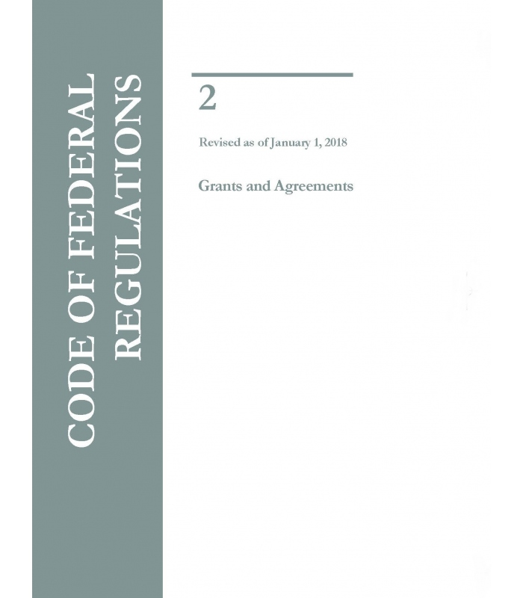
Financial Management
Federal Regulations: 2 CFR Part 200
Uniform Administrative Requirements, Cost Principles, and Audit Requirements for Federal Awards.
Rules apply to all awards.
Notes:
2CFR is the federal regulation that governs your award.
We encourage you to become familiar with it.

Slide 44
Project Costs
Must comply with the Uniform Administrative Requirements, Cost Principles, and Audit Requirements at 2 C.F.R. Part 200, unless otherwise indicated in the NOFO or the terms and conditions of the award.
SAA may only fund and charge activities and projects that are included and approved in the FY 2021 HHPD Program Work Plan and Budget Detail.
Requirements Related to Contractor and Subcontractor Wages
Recipients and Subrecipients are required to comply with the requirements of 42 U.S.C. § 5196(j)(9).
Notes:
Award funds may not be used for matching funds for any other federal grants/cooperative agreements, lobbying, or intervention in federal regulatory or adjudicatory proceedings. In addition, federal funds may not be used to sue the federal government or any other government entity.

Slide 45
Management and Administration (M&A) Costs
A maximum of up to 10% of HHPD funds awarded may be retained by the state, and any funds retained are to be used solely for M&A purposes associated with the HHPD award.
Applicant requests for management costs must be included in the State Administrative Plan.
Management and administration (M&A) activities are those directly relating to the management and administration of HHPD funds, such as financial management and monitoring.
Subrecipients may also retain a maximum of up to 5% of the funding passed through by the state solely for M&A purposes associated with the HHPD award.
Subrecipient management cost activities must be added to the scope of work section and reflected in the cost estimate section of subgrant applications.

Slide 46
Cost-share or Match
Assistance provided under the HHPD Grant Program is subject to a non-federal cost-sharing requirement of not less than 35%.
Federal funding is available for up to 65% of the eligible activity costs. The remaining 35% of eligible activity costs must be derived from non-federal sources, which may be in-kind.
The Cost-share or Match can either be derived from the applicant, subrecipient or a combination of both
Required: Quarterly reporting on % Cost-share expended
Project over-run can be supported with additional Cost-share – consult with Program Officer.
Notes:
Requirements for cash and third-party in-kind contributions can be found in 2 C.F.R. § 200.306. The non-federal cost share contribution is not limited to 65 percent. The non-federal cost share contribution is calculated based on the total cost of the proposed activity. For example, if the total cost is $400,000 and the non-Federal cost share is 35 percent, then the non-federal contribution is $140,000: 35 percent of $400,000 is $140,000. The federal share cannot exceed $260,000 ($400,000 x 65%).

Slide 47
Management and Administration (M&A) Costs
Activities are those directly relating to the management and administration of HHPD funds, such as financial management and monitoring
Maximum of up to 10% of HHPD funds awarded may be retained by the state
Funds retained are to be used solely for M&A purpose associated with the HHPD award; allocated across the entire lifecycle of the grant
Subrecipients may also retain a maximum of up to 5% of the funding passed through by the state solely for M&A purposes associated with the HHPD award; management cost activities must be added to the scope of work section and reflected in the cost estimate section of subgrant applications
Applicant requests for management costs must be included in the State Administrative Plan (Amend)

Slide 48
Procurement
Procuring property and services under a federal award
a grantee or subrecipient must follow the same policies and procedures it uses for procurements from its non-federal funds
Requirements outlined in 2 CFR Section 200.317. All other recipients and subrecipients (not a state) must follow 2 CFR Sections 200.318 through 200.326
Notes:
Page 24 HHPD-G
Applies to subaward < (less than $1,000,000.00

Slide 49
Financial Reporting: Accurate Data
SAA: Required to expend and account for grant funds
  State laws/procedures
  Internal accounting system
Federal Financial Report (FFR) SF 425 used for all recipients
Reporting requirements found in Grant Terms and Conditions and/or the Notice of Funding Opportunity (NOFO) / Program Guidance.
Specific instructions for each line item of the report can be found at the following website:
  http://www.whitehouse.gov/omb/assets/omb/grants/standard_forms/ffr_instructions.pdf
Notes:
All expended funds should be accounted for and recorded on the SF-425’s
Reporting requirements can be found in Grant Terms and Conditions/NOFO
Recipients should report quarterly all money they currently have and money they have already spent

Slide 50
Program and Financial Reporting Schedule
Quarter | Calendar Quarter | Report Due Date | E-mail Reminder Sent
First Quarter | Oct 1 – Dec 31 | Jan 30 | Jan 31
Second Quarter | Jan 1 – Mar 31 | Apr 30 | May 1
Third Quarter | Apr 1 – Jun 30 | Jul 30 | Jul 31
Fourth Quarter | Jul 1 – Sep 30 | Oct 30 | Oct 31
Notes:
1. This table outlines the reporting schedule for financial and programmatic reporting
Reporting deadlines are listed in chart above
The dates for reporting deadlines are also included in the main page of the PARS and the NOFO
Late reporting can be a finding and designate you as “high risk” recipient. It may also increase your chances of an on-site monitoring visit.
On time reporting is a requirement. Even if a payment request has not been submitted

Slide 51
Federal Financial Reporting Requirements
SAA must report obligations and expenditures on a quarterly basis through the FFR (SF-425) to DHS/FEMA. https://www.grants.gov/web/grants/forms/post-award-reporting-forms.html#sortby=1
The Federal Financial Report (FFR) form is available online at: SF-425 OMB #4040-0014
Recipients must file the FFR quarterly, using the Payment and Reporting System (PARS), throughout the period of performance, including partial calendar quarters, as well as for periods where no grant award activity occurs. The final FFR is due 90 days after the end of the performance period. Future awards and fund drawdowns may be withheld if these reports are delinquent, demonstrate lack of progress, or are insufficient in detail.
Notes:
Federal Financial Report (FFR) form is available online at: SF-425 OMB #4040-0014

Slide 52
Extensions and Amendments

Slide 53
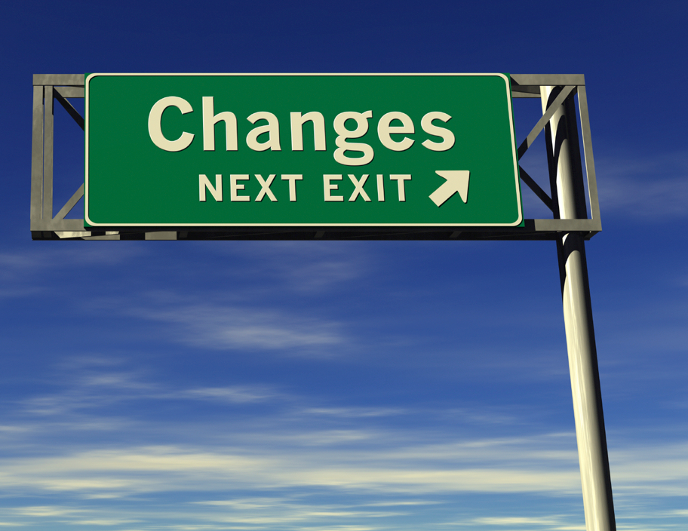
Amendments = Change
An amendment is a formal written change to the award that typically requires prior written approval from FEMA in accordance with 2 CFR Part 200.
Amendments are covered in 2 CFR 200.308.
Notes:
Background:
An amendment is an official revision to the award
And verifies FEMA’s approval of the change or modification to the award documentation
There are instances were a post-award change to a budget or project objective may occur
Please note these certain types of changes require prior written approval and acceptance by FEMA
Amendments are submitted and processed in ND Grants

Slide 54
Extensions
Extensions to the period of performance under this program are allowed on case-by-case basis.
Applicants must submit extension requests within sixty (60) calendar days prior to the period of performance end date
Written requests to the FEMA/ Federal Insurance and Mitigation Administration, Risk Management Directorate
  Grant Program, Grant Year, and award number;
  Reason for extension – this must include details of the legal, policy, or operational challenges being experienced that prevent the final outlay of awarded funds by the applicable deadline. The reason must also be of significant extenuating circumstances (e.g. local flooding disaster);
  Current status of the activity/activities;
  Approved period of performance termination date and new project completion date (New recommended POP);
  Amount of funds drawn down to date;
  Remaining available funds;
  Revised delineated budget outlining how remaining federal grant funds will be expended by approved task;
  Plan for completion including milestones and timeframes for achieving each milestone and the position/person responsible for implementing the plan for completion; and
  Certification that the activity/activities will be completed within the extended period of performance without any modification to the original Statement of Work approved by FEMA.
Notes:
Extensions to the initial period of performance identified in the award will be considered only through formal, written requests to the FEMA/ Federal Insurance and Mitigation Administration, Risk Management Directorate and must contain specific and compelling justifications as to why an extension is required. States are advised to coordinate with the FEMA Federal Insurance and Mitigation Administration, Risk Management Directorate as needed, when preparing an extension.
Applicants must submit extension requests within sixty (60) calendar days prior to the period of performance end date, through the ND Grants system, for review by the FEMA National Dam Safety Office for final review and Amendment approval consideration. Extension requests must meet the Extensions requirements as listed above.

Slide 55
Monitoring and Site Visit
Per 2 C.F.R. § 200.336
DHS/FEMA has the right, to make site visits to review project accomplishments and management control systems
Provides technical assistance as needed
During site visits
Grant recipient files and records related to the grant award are reviewed
Interview the organization’s staff and contractors
Recipients must respond in a timely and accurate manner to DHS/FEMA requests for information relating to the grant program.
Notes:
DHS/FEMA through its authorized representatives, has the right, at all reasonable times, to make site visits to review project accomplishments and management control systems to review project accomplishments and to provide any required technical assistance.
During site visits, DHS/FEMA will review grant recipients’ files related to the grant award. As part of any monitoring and program evaluation activities, grant recipients must permit DHS/FEMA, upon reasonable notice, to review grant-related records and to interview the organization’s staff and contractors regarding the program. Recipients must respond in a timely and accurate manner to DHS/FEMA requests for information relating to the grant program

Slide 56
Closeout Requirements
Within 90 days after the end of the period of performance, or after an amendment has been issued to close out a grant, recipients must submit the following:
1) The final Federal Financial Report (FFR)
2) The final progress report detailing separately AA & IIJA accomplishments;
  A qualitative narrative summary of the impact of those accomplishments throughout the period of performance to align with performance metric
  Other documents required by this NOFO, terms and conditions of the award, or other DHS/FEMA guidance.
If applicable, an inventory of all construction projects that used funds from this program must be reported with the final progress report.
Notes:
After final reports have been reviewed and approved by DHS/FEMA, a closeout notice will be completed to close out the grant.
The notice will indicate the period of performance as closed, list any remaining funds that will be deobligated, and address the requirement of maintaining the grant records for three years from the date of the final FFR, unless a longer period applies, such as due to an audit or litigation, for equipment or real property used beyond the period of performance, or due to other circumstances outlined in 2 C.F.R. § 200.333.

Slide 57
Subawards Closeout
An SAA that issues subawards to a subrecipient is responsible for closing out those subawards as described in 2 C.F.R. § 200.343.
SAA acting as pass-through entities must ensure complete closeout of subawards in time to submit all necessary documentation and information to DHS/FEMA during the closeout of their prime grant award.

Slide 58
Know Your Points of Contact
Program Officer- Conducts all programmatic pre-award, award and post-award activity. Reviews programmatic reports and project activity.
HQ Grants Management Specialist - Conducts all financial pre-award and post-award grant administrative functions.

Slide 59
Closing

